Slide 1
Introduction to Python for Image Processing
Instructor:
Junyu Chen (Day1 & Day2)
Prof. Marvin Doyley (Day3)

Slide 2
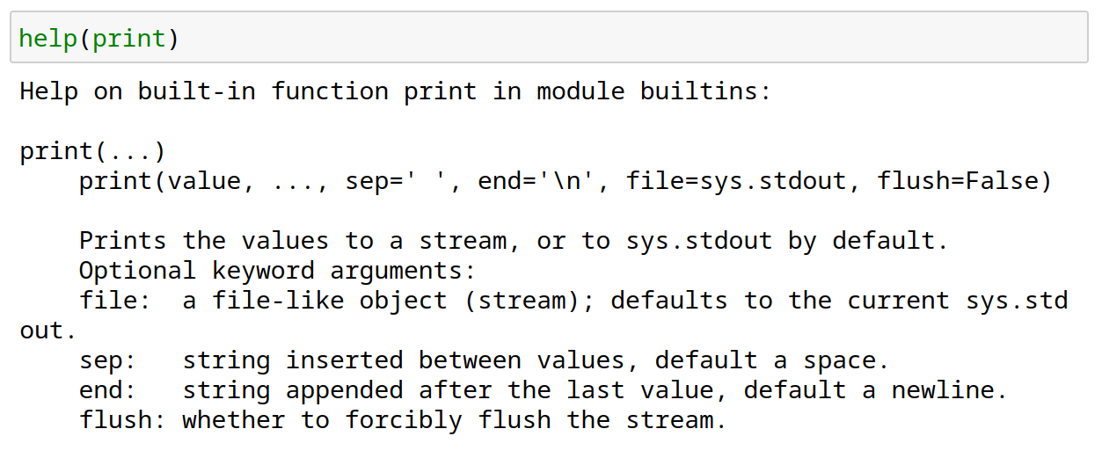
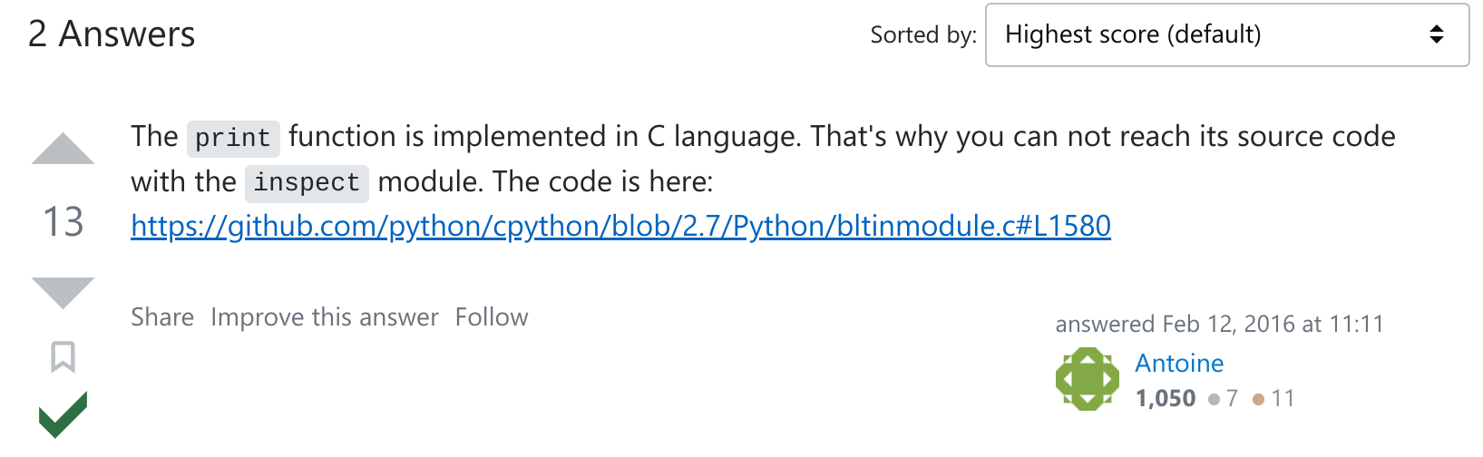
Functions
Example – projector
a projector is a black box
do not know how it works
know the interface: input/output
connect any electronic to it that can communicate
with that input
black box somehow converts image from input source
to a wall, magnifying it
ABSTRACTION IDEA: do not need to know how projector works to use it
https://stackoverflow.com/questions/35360988/how-to-get-source-code-of-python-print-function
Credit: Ana Bell, Eric Grimson, John Guttag (2016). Introduction to Computer Science and Programming in Python [PowerPoint slides].
Notes:
In Python, a function is a block of organized, reusable code that performs a specific task.
It acts as a black box where you provide input, and it produces the desired output without needing to know the internal implementation details.
Python provides a rich set of built-in functions, such as the print() function. These functions are readily available for use without requiring you to know their internal workings.
Using the print() function as an example, you can call it and pass the desired data as an argument, and it will display the output on the console.
You don't need to worry about the underlying implementation details of how the data is printed or the technicalities of the console interaction.
The function abstracts away those complexities, allowing you to focus on using it effectively.

Slide 3
Functions
write reusable pieces/chunks of code, called functions
functions are not run in a program until they are “called” or “invoked” in a program
function characteristics:
has a name
has parameters (0 or more)
has a docstring (optional but recommended)
has a body
returns something (0 or more)
Credit: Ana Bell, Eric Grimson, John Guttag (2016). Introduction to Computer Science and Programming in Python [PowerPoint slides].
Notes:
Functions in Python allow you to write reusable pieces or chunks of code that can be called or invoked within a program.
They are not executed in the program until they are specifically called. Each function has several characteristics.
First, it has a name that serves as its identifier. This name is used to call the function and execute the code inside it.
Additionally, functions can have parameters, which are placeholders for the values or data that need to be passed to the function for processing. Parameters can be optional or required, depending on how the function is defined.
It is also recommended to include a docstring, which is an optional string that provides a description of the function's purpose, usage, and any additional details.
The body of the function contains the code that is executed when the function is called.
Finally, functions can return values, which can be zero or more, depending on the logic inside the function.
The return statement allows the function to send back data to the code that called it, allowing for further processing or utilization.

Slide 4
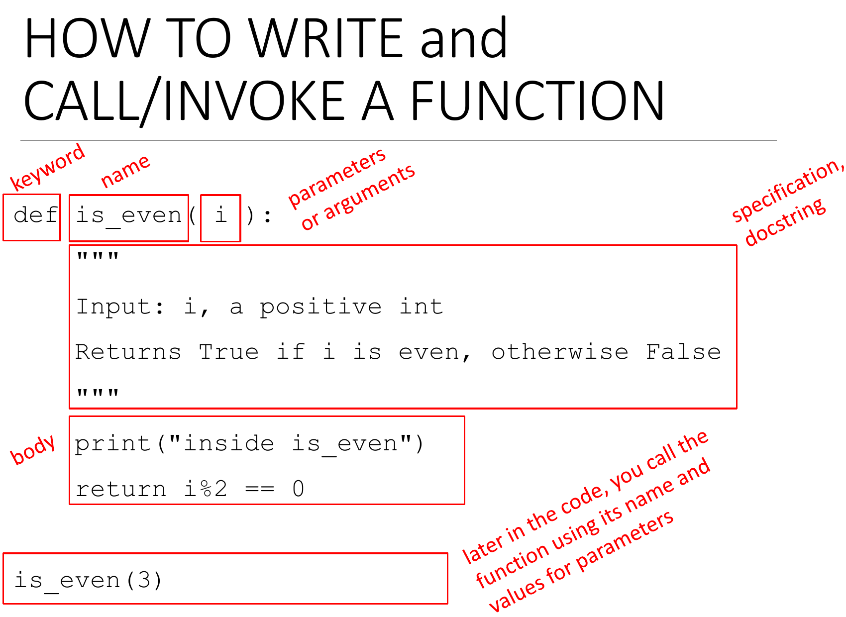
Functions
Credit: Ana Bell, Eric Grimson, John Guttag (2016). Introduction to Computer Science and Programming in Python [PowerPoint slides].
Notes:
To write a function in Python, you follow these steps:
Use the def keyword followed by the function name and parentheses () to define the function. For example: def my_function():
Optionally, include parameters inside the parentheses if your function needs to accept input values. Parameters are placeholders for data that will be passed to the function when it is called. For example: def my_function(parameter1, parameter2):
Add a colon : at the end of the function definition line to indicate the start of the function's body.
Indent the code within the function body. The indented code represents the statements and logic that will be executed when the function is called.
Optionally, include a return statement to specify the value or values that the function will send back as a result. The return statement ends the function execution and returns the value to the calling code.
To call or invoke a function in Python, you
Simply write the function name followed by parentheses () and any required arguments or values inside the parentheses. For example: my_function() or my_function(arg1, arg2).
When the function is called, the code inside the function's body will be executed, and any specified return values will be sent back to the calling code.
Remember that the function definition must come before the function call in your code. This ensures that the function is defined and available for use when you try to call it.

Slide 5
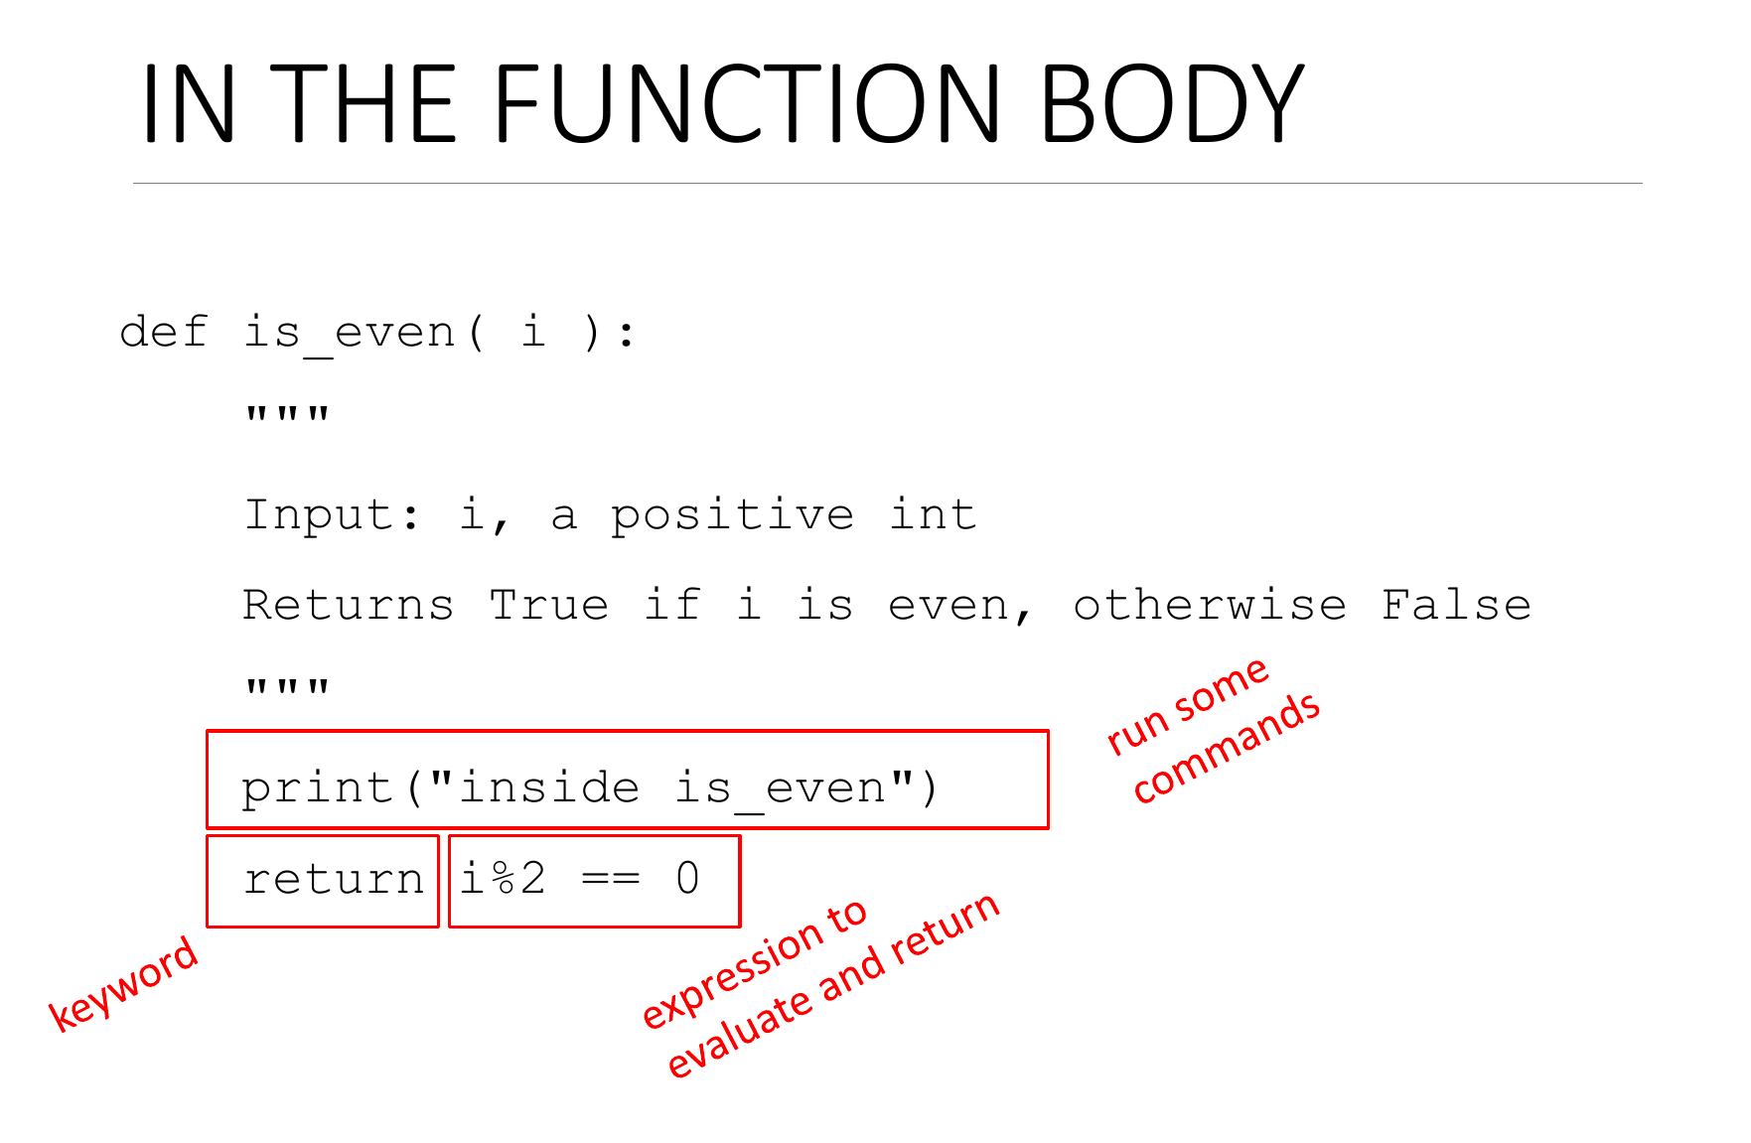
Functions
Credit: Ana Bell, Eric Grimson, John Guttag (2016). Introduction to Computer Science and Programming in Python [PowerPoint slides].
Notes:
Here is what is typically inside a function body. You do some operation based on the input arguments, and return the results you need.

Slide 6
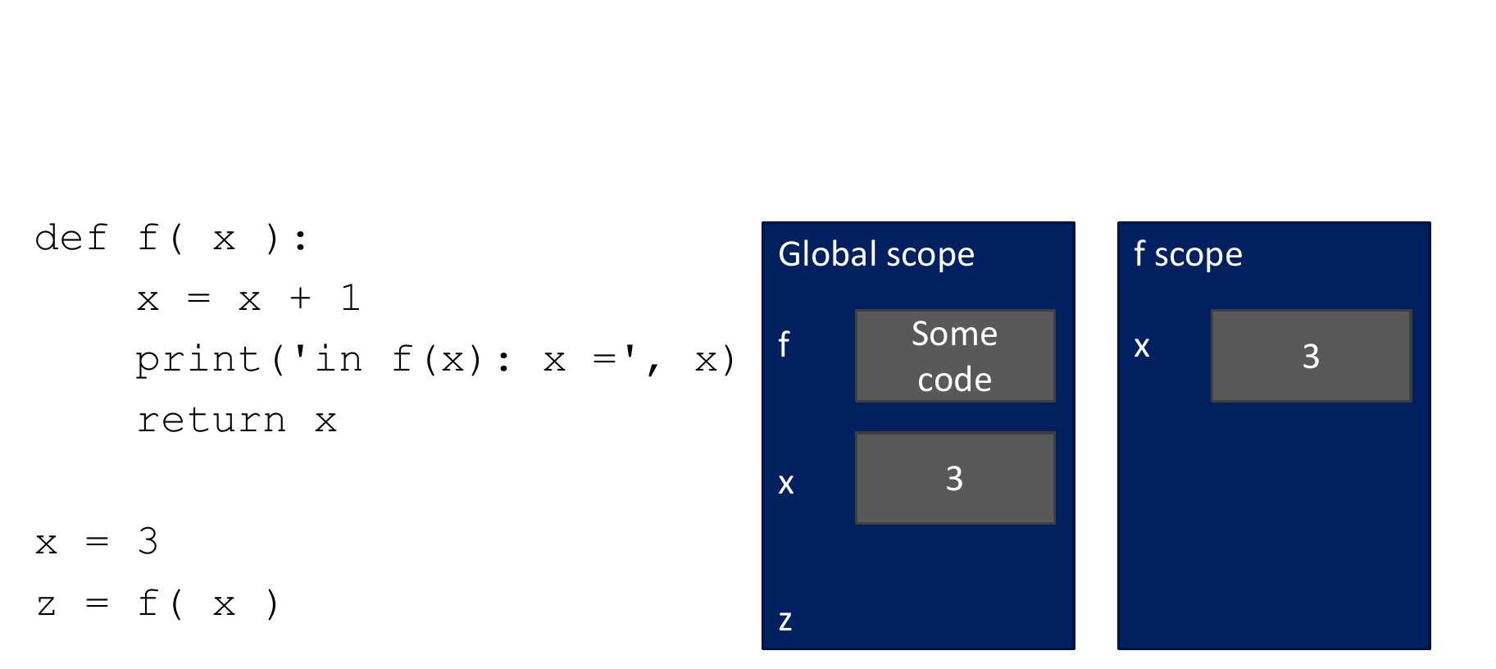
Variable Scope
Credit: Ana Bell, Eric Grimson, John Guttag (2016). Introduction to Computer Science and Programming in Python [PowerPoint slides].
Notes:
Here is the concept of variable scope:
Variable scope refers to the visibility and accessibility of variables within different parts of a program.
In Python, variables have different scopes depending on where they are defined.
In this code example, we have two variables named x: one inside the function f() and another one outside the function.
The x variable defined inside the function f() is a local variable. It is only accessible within the function's scope. Any changes made to this local x variable will not affect the x variable defined outside the function.

Slide 7
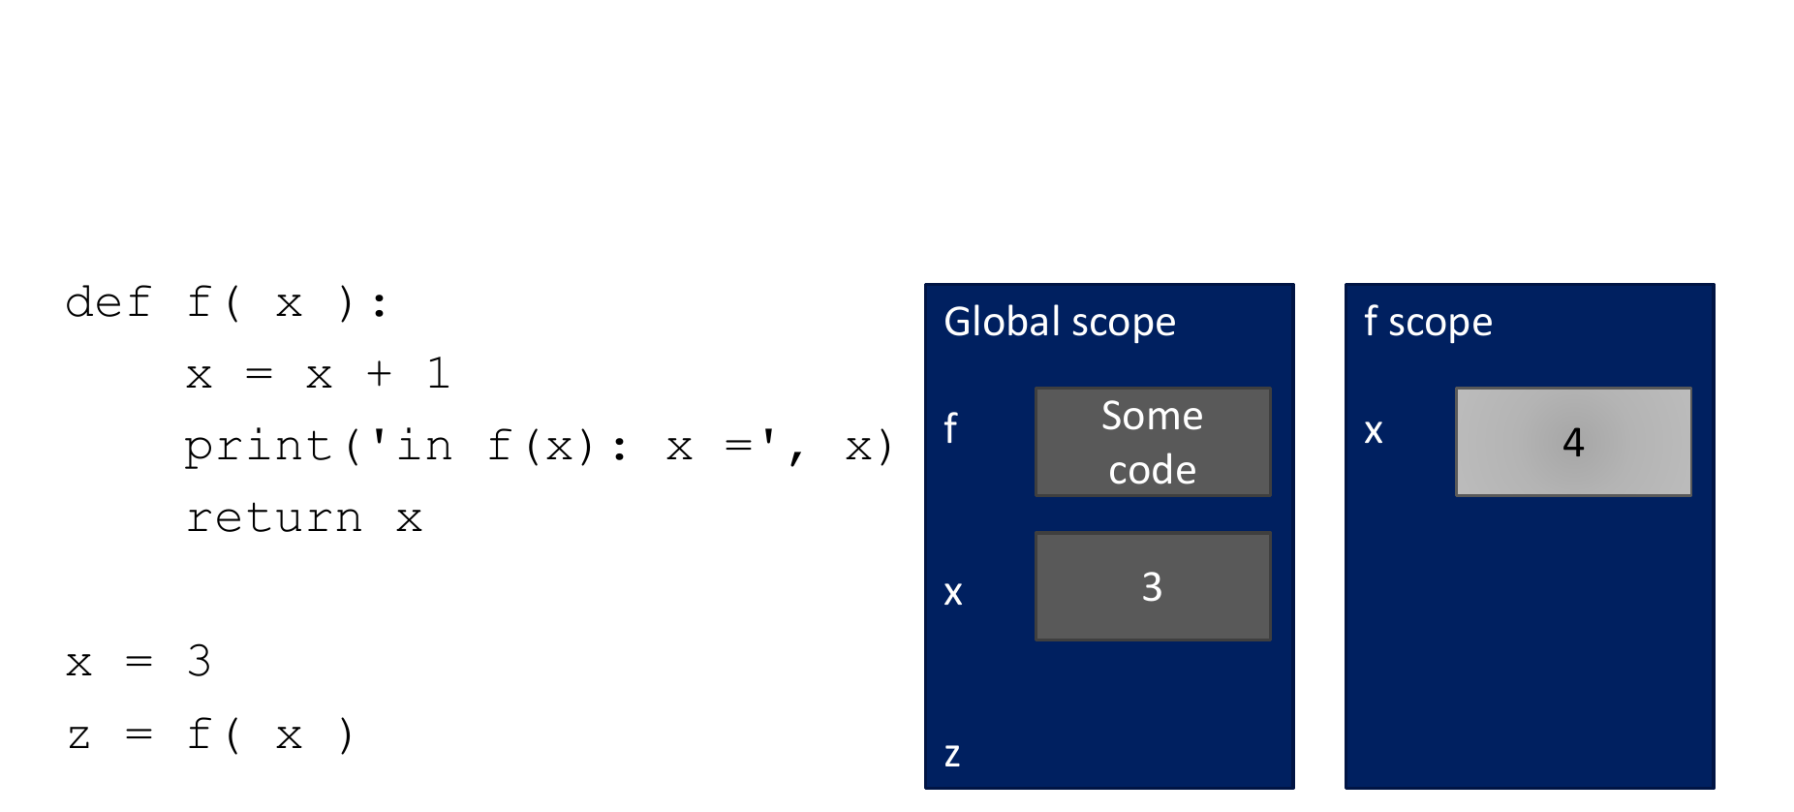
Variable Scope
Credit: Ana Bell, Eric Grimson, John Guttag (2016). Introduction to Computer Science and Programming in Python [PowerPoint slides].
Notes:
The x variable defined outside the function f() is a global variable. It is accessible throughout the entire program, including within the function. Changes made to this global x variable can be seen both inside and outside the function.
Here's a breakdown of the code's execution:

Slide 8
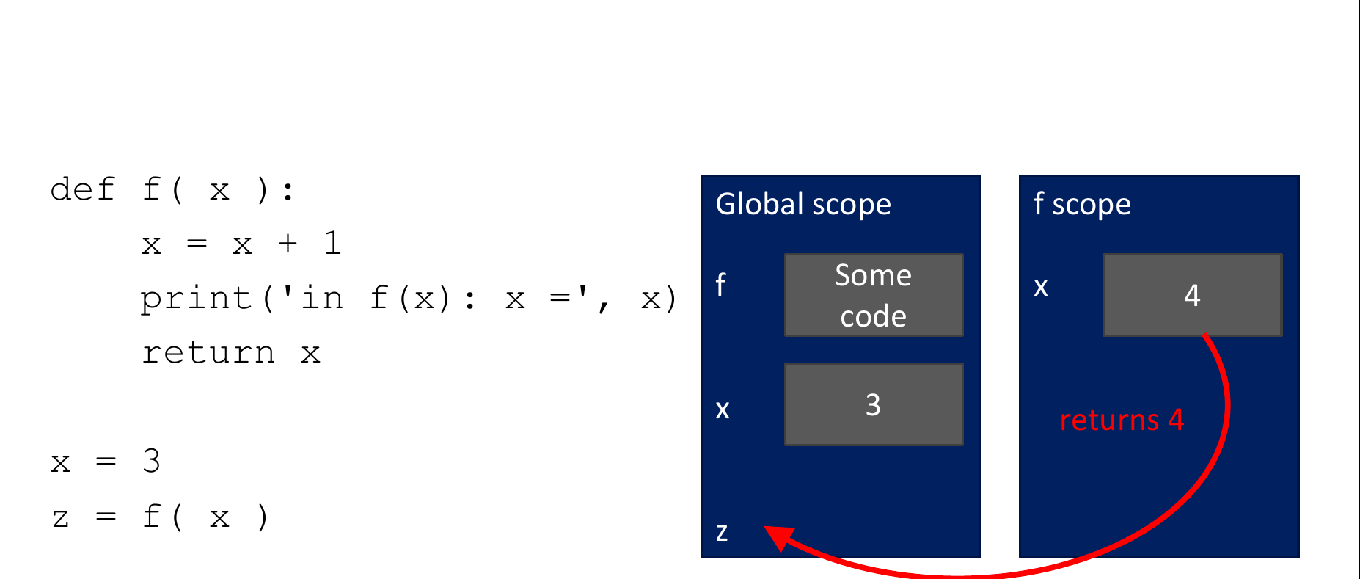
Variable Scope
Credit: Ana Bell, Eric Grimson, John Guttag (2016). Introduction to Computer Science and Programming in Python [PowerPoint slides].
Notes:
We define the function f(x) which takes a parameter x. Within the function, a new local variable x is created and assigned the value of x + 1.
Inside the function, we print the value of the local x variable using print('in f(x) x= ', x).
The function f(x) is called with x being assigned the value of 3 outside the function. This creates a new local x variable with the value 4 (as x + 1 is computed).
The value of the local x variable (4) is assigned to the variable z.
The program prints the output in f(x) x= 4.
The global x variable (3) remains unchanged.

Slide 9
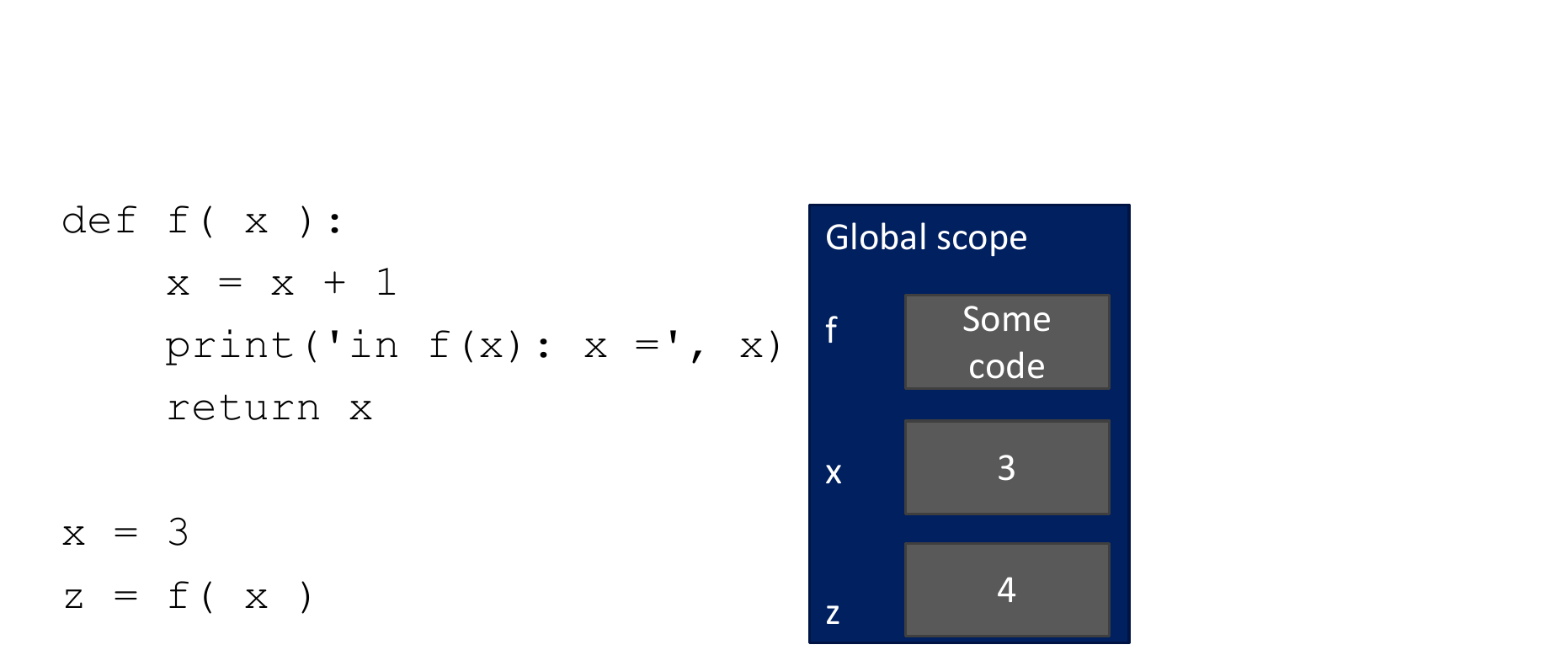
Variable Scope
Credit: Ana Bell, Eric Grimson, John Guttag (2016). Introduction to Computer Science and Programming in Python [PowerPoint slides].
Credit: Ana Bell, Eric Grimson, John Guttag (2016). Introduction to Computer Science and Programming in Python [PowerPoint slides].
Notes:
This example demonstrates the difference between local and global variable scope.
The local x variable within the function f() is confined to the function's scope and does not affect the global x variable defined outside the function.
Understanding variable scope is important for managing data and ensuring that variables are used and updated appropriately within different parts of a program.

Slide 10
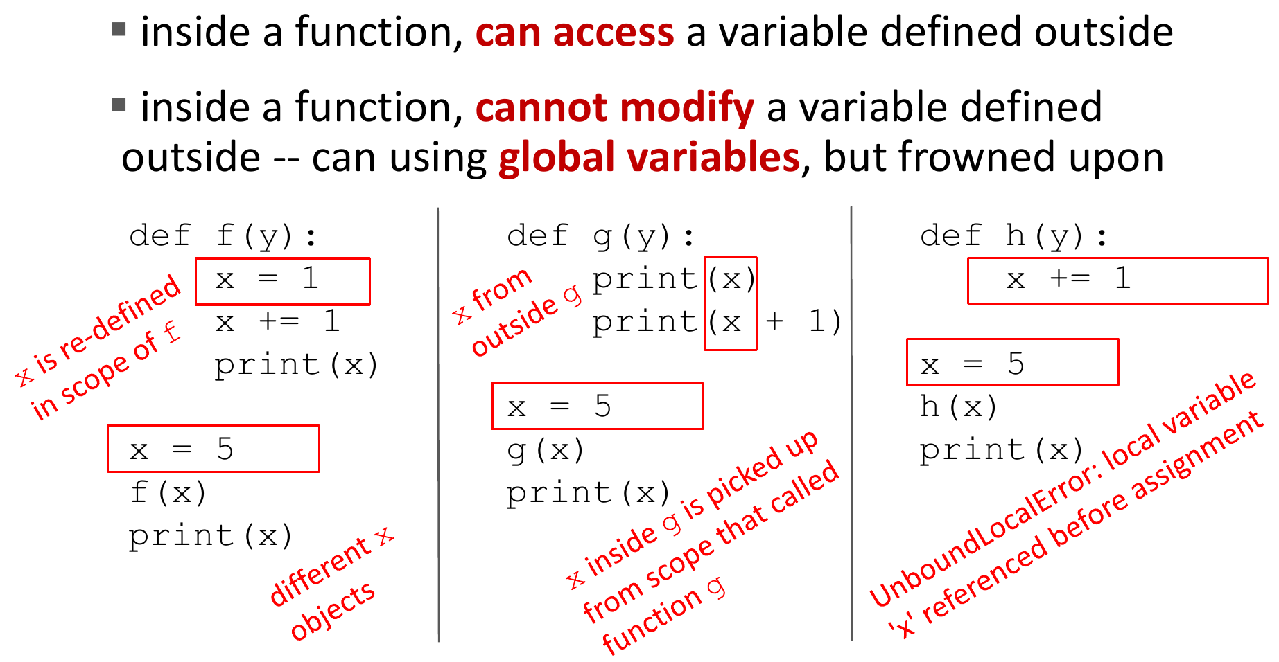
Scope Example
Credit: Ana Bell, Eric Grimson, John Guttag (2016). Introduction to Computer Science and Programming in Python [PowerPoint slides].
Notes:
The local x variable within the function f() is confined to the function's scope and does not affect the global x variable defined outside the function.
Understanding variable scope is important for managing data and ensuring that variables are used and updated appropriately within different parts of a program.

Slide 11
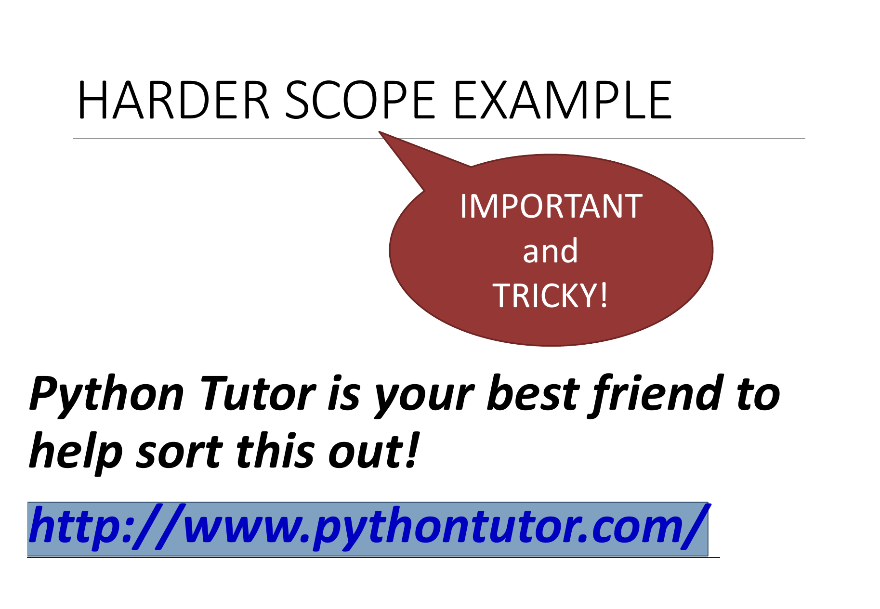
http://www.pythontutor.com/
Credit: Ana Bell, Eric Grimson, John Guttag (2016). Introduction to Computer Science and Programming in Python [PowerPoint slides].

Slide 12
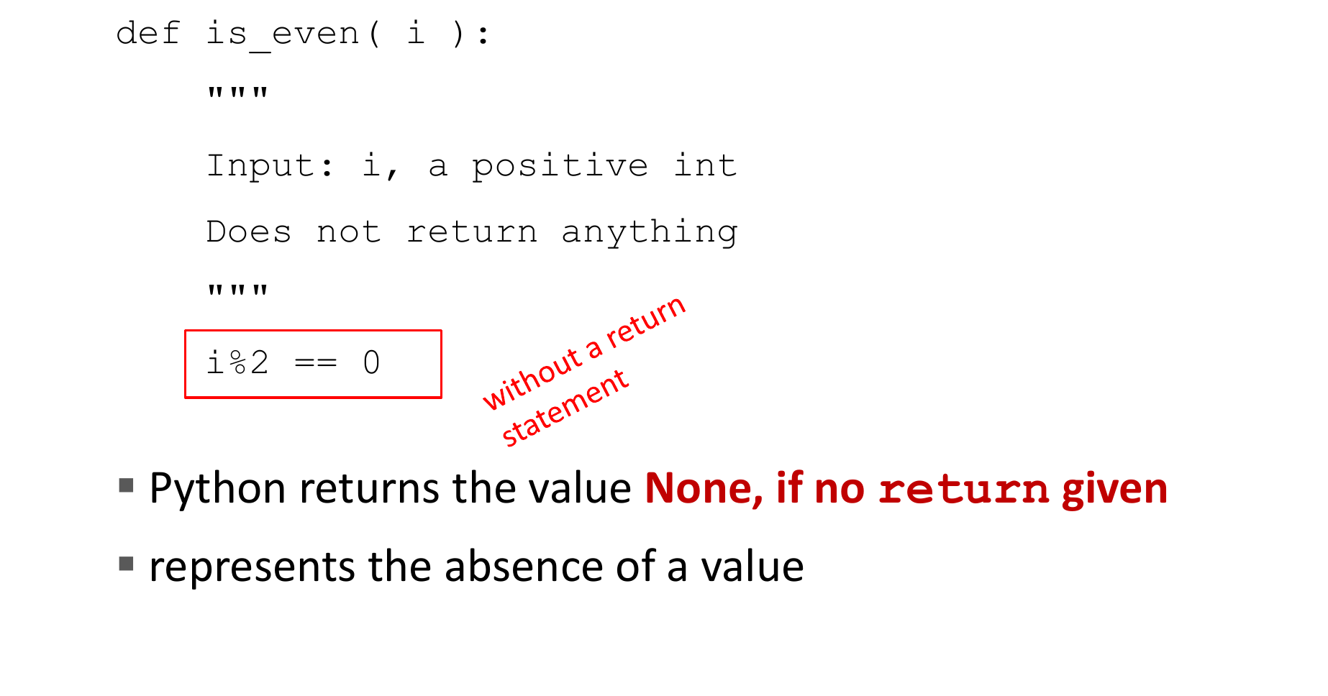
If No return is Given:
Credit: Ana Bell, Eric Grimson, John Guttag (2016). Introduction to Computer Science and Programming in Python [PowerPoint slides].
Credit: Ana Bell, Eric Grimson, John Guttag (2016). Introduction to Computer Science and Programming in Python [PowerPoint slides].
Notes:
If no return statement is given in a function, the function will implicitly return None by default.
None is a special Python object that represents the absence of a value.
It is often used to indicate that a function does not return any specific value or that the returned value is not meaningful.

Slide 13
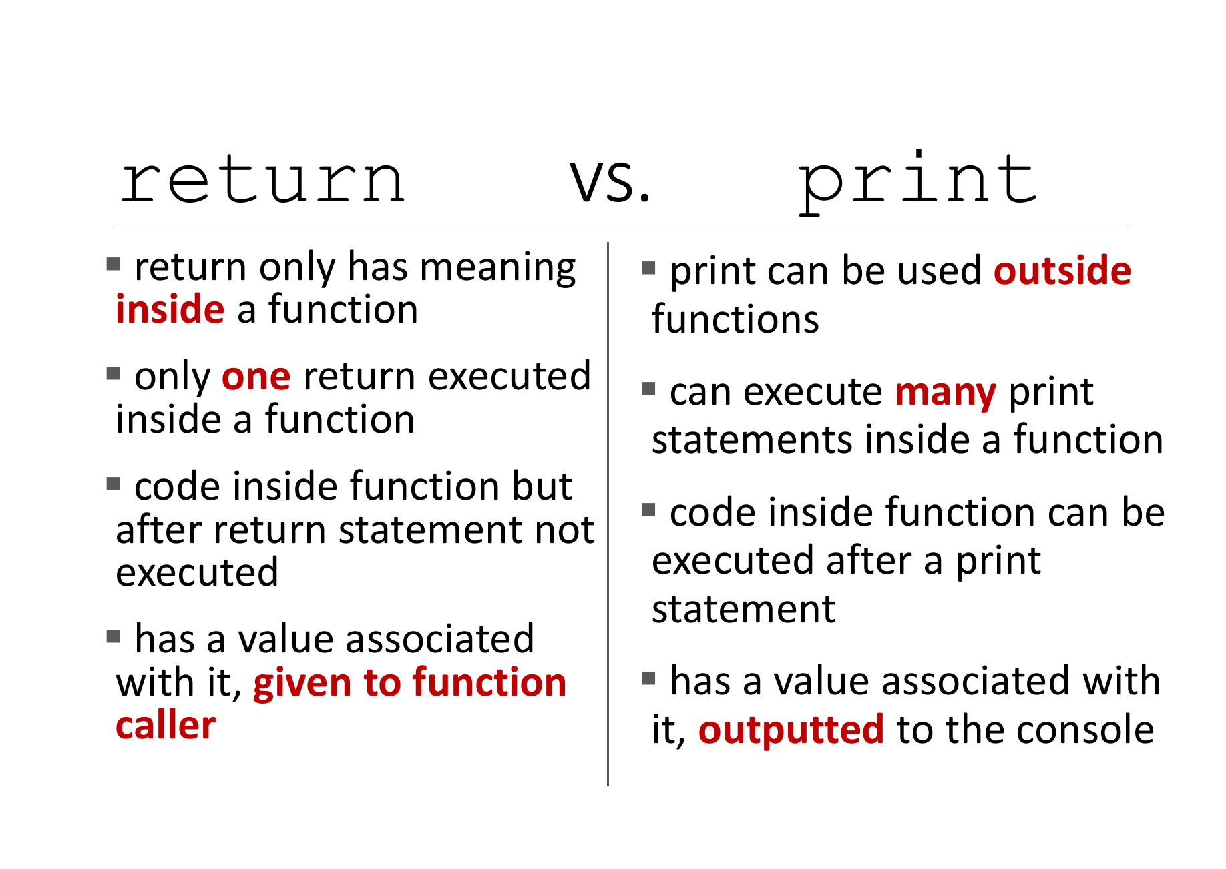
Credit: Ana Bell, Eric Grimson, John Guttag (2016). Introduction to Computer Science and Programming in Python [PowerPoint slides].
Notes:
In summary, the main differences between return and print() are three points:
Purpose: return is used to specify the value(s) to be returned from a function, while print() is used to display output to the console or output device.
Flow of execution: return ends the execution of the function and transfers control back to the caller, while print() does not affect the flow of the program and allows the program to continue executing.
Data passing: return passes data back to the calling code, allowing it to be stored in variables or used in further computations, while print() does not pass data back to the calling code.

Slide 14
Exercise: Maximum of Two Numbers
Write a function called find_maximum() that takes two numbers as arguments and returns the maximum of the two numbers. The function should compare the two numbers and determine which one is larger, and then return the larger number as the result.
def find_maximum(num1, num2):

Slide 15
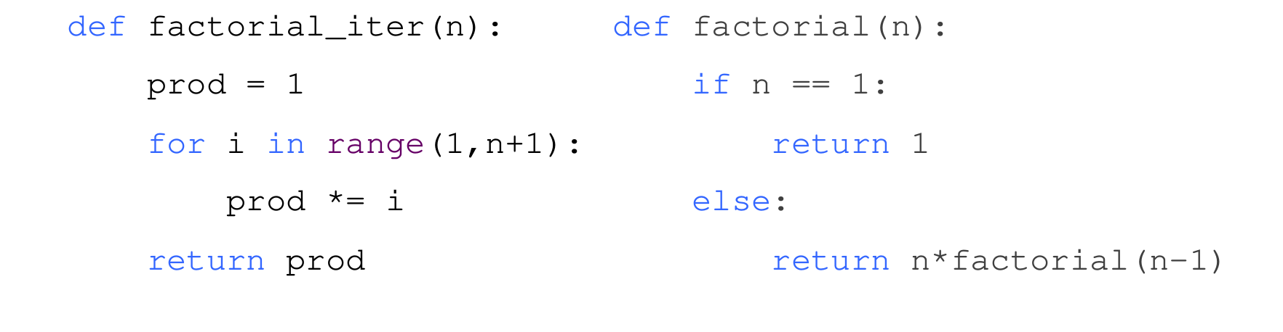
Iteration vs. Recursion
Credit: Ana Bell, Eric Grimson, John Guttag (2016). Introduction to Computer Science and Programming in Python [PowerPoint slides].
Notes:
Here I want to talk a little bit about Iteration and recursion
They are two different approaches to solving problems in programming.
Iteration involves using loops, such as for and while loops, to repeatedly execute a block of code until a certain condition is met.
It follows a step-by-step approach, where the code is executed sequentially in a loop.
Recursion involves a function calling itself to solve a problem by breaking it down into smaller, similar subproblems.
It follows a divide-and-conquer approach, where the problem is divided into smaller instances that are solved recursively.
For example, if we want to define a function to calculate the factorial
In the iterative approach, we use a for loop to iterate from 1 to n, multiplying the current number with the accumulating result. This way, we calculate the factorial iteratively by repeatedly updating the result variable.
In the recursive approach, we define the base case where n is 0 or 1, and in all other cases, we call the factorial function with n - 1 and multiply the current number n with the result of the recursive call. This way, we break down the factorial problem into smaller subproblems until we reach the base case.
And besides, from this example we can see that a function can be called from other functions, even itself.

Slide 16
Class
Object-Oriented Programming (OOP):
Python is an object-oriented programming language, which means it focuses on creating objects as the primary building blocks of programs.
OOP allows us to organize code into modular and reusable units, making it easier to manage and maintain complex projects.
Credit: Ana Bell, Eric Grimson, John Guttag (2016). Introduction to Computer Science and Programming in Python [PowerPoint slides].
Notes:
In Python, a class is a blueprint or a template for creating objects.
It provides a way to define the structure, behavior, and attributes that objects of that class should have.
Let's break down the concept of a class in Python:

Slide 17
Class
Class Definition:
A class is defined using the class keyword followed by the name of the class.
It serves as a blueprint that defines the properties and behaviors (methods) that objects of that class will possess.
For example, a class called Car can define properties like color, make, and model, as well as behaviors like start_engine() or accelerate().
Credit: Ana Bell, Eric Grimson, John Guttag (2016). Introduction to Computer Science and Programming in Python [PowerPoint slides].
Notes:
Class Definition:
A class is defined using the class keyword followed by the name of the class.
It serves as a blueprint that defines the properties and behaviors (methods) that objects of that class will possess.
For example, a class called Car can define properties like color, make, and model, as well as behaviors like start_engine() or accelerate().

Slide 18
Class
Objects and Instances:
Once a class is defined, we can create objects or instances of that class.
An object is an instance of a class, representing a specific occurrence or entity.
For instance, we can create multiple instances of the Car class, each representing a different car with its own set of properties and behaviors.
Credit: Ana Bell, Eric Grimson, John Guttag (2016). Introduction to Computer Science and Programming in Python [PowerPoint slides].
Notes:
Objects and Instances:
Once a class is defined, we can create objects or instances of that class.
An object is an instance of a class, representing a specific occurrence or entity.
For instance, we can create multiple instances of the Car class, each representing a different car with its own set of properties and behaviors.

Slide 19
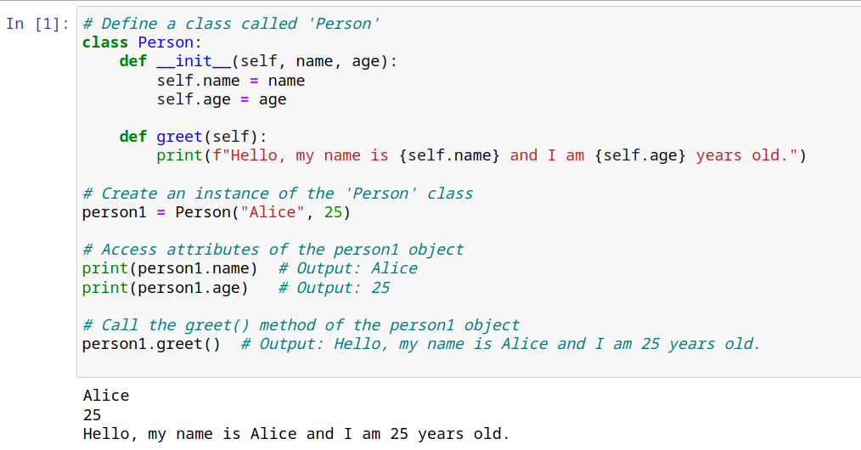
Class
Credit: Ana Bell, Eric Grimson, John Guttag (2016). Introduction to Computer Science and Programming in Python [PowerPoint slides].
Notes:
In this example, we define a class called Person.
The Person class has two attributes: name and age.
The __init__() method is a special method that gets called when an object is created from the class.
It takes the name and age arguments and assigns them to the corresponding attributes of the object.

Slide 20
Class
Credit: Ana Bell, Eric Grimson, John Guttag (2016). Introduction to Computer Science and Programming in Python [PowerPoint slides].
Notes:
The Person class also has a method called greet(). This method prints a greeting message using the name and age attributes of the object.
The self parameter refers to the instance of the class, allowing us to access its attributes and methods.

Slide 21
Class
Credit: Ana Bell, Eric Grimson, John Guttag (2016). Introduction to Computer Science and Programming in Python [PowerPoint slides].
Notes:
We create an instance of the Person class called person1 by calling the class as if it were a function.
We pass the values "Alice" and 25 as arguments to the __init__() method, which initializes the name and age attributes of the person1 object.
We can then access the attributes of the person1 object using dot notation (person1.name, person1.age). Finally, we call the greet() method of the person1 object to print a greeting message using its attributes.

Slide 22
Exercise: Bank Account Class
Define a class called BankAccount.
The class should have the following attributes: account_number, owner_name, and balance.
Implement the __init__() method to initialize the attributes.
Implement the following methods:
deposit(amount): Adds the given amount to the account's balance.
withdraw(amount): Subtracts the given amount from the account's balance.
get_balance(): Returns the current balance of the account.
display_account_info(): Prints the account information (account number, owner name, and balance).

Slide 23
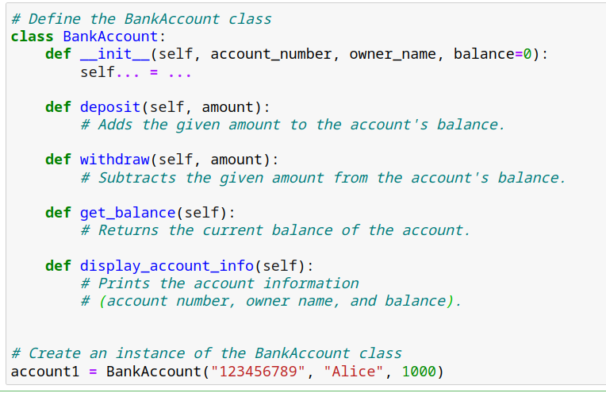
Exercise: Bank Account Class

Slide 24
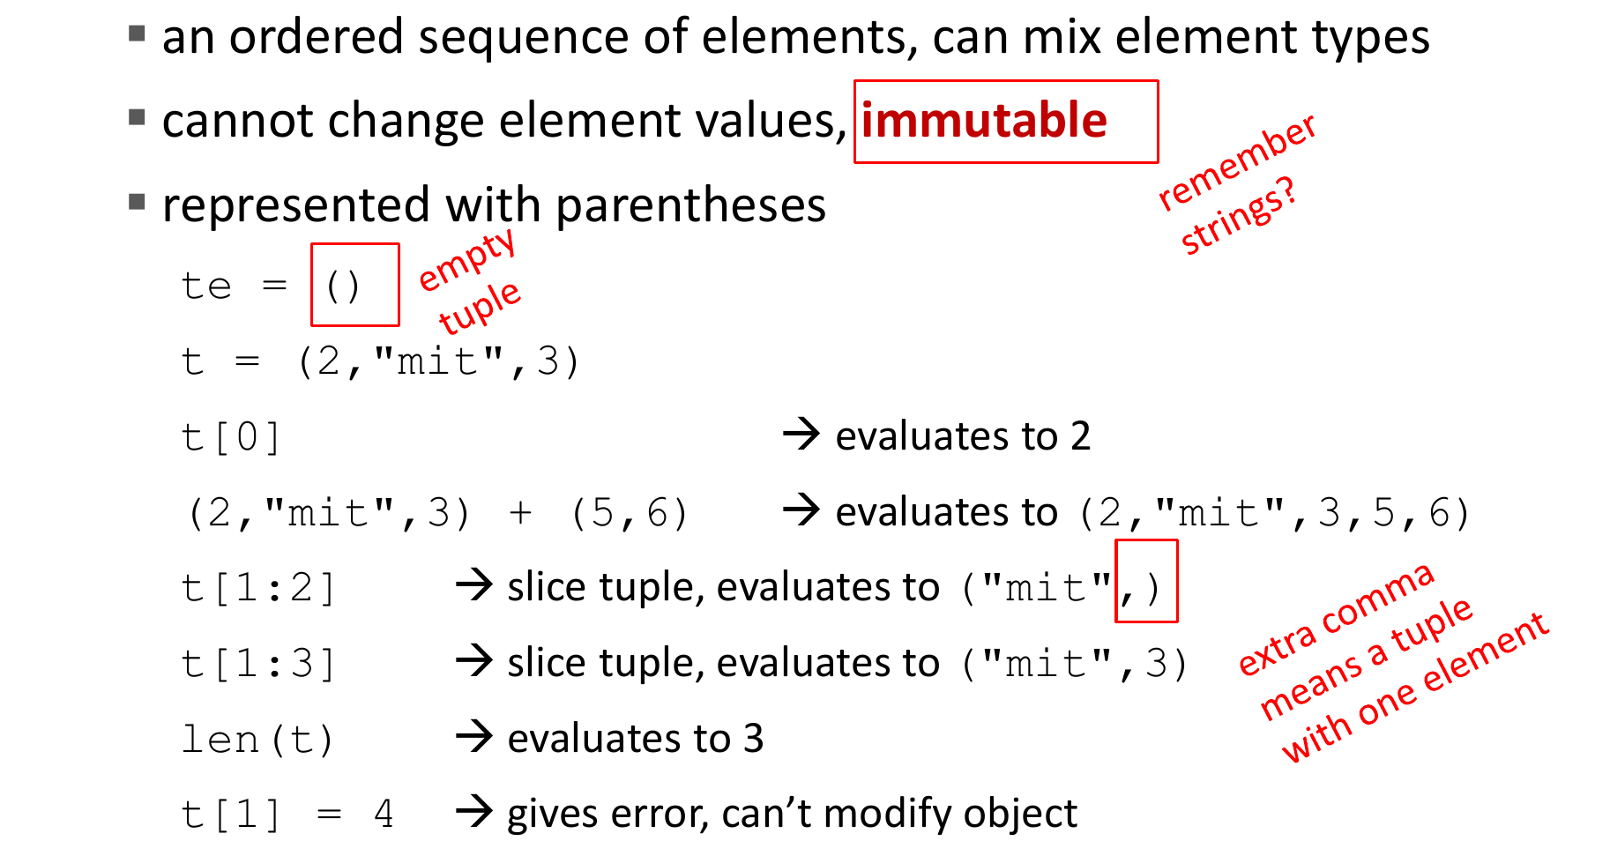
Tuples
Notes:
In Python, a tuple is an ordered, immutable sequence of elements, enclosed in parentheses ( ).
Tuples are similar to lists, which we will talk about later, but the key difference is that tuples cannot be modified once they are created.
Tuples can contain elements of different data types, including numbers, strings, booleans, and even other tuples.
Here is how to access elements within a tuple:
Individual elements in a tuple can be accessed using indexing.
Indexing starts at 0, so the first element is accessed with index 0, the second with index 1, and so on.

Slide 25
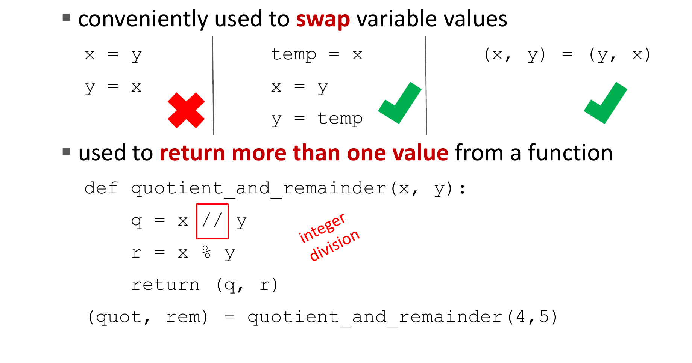
Tuples
Credit: Ana Bell, Eric Grimson, John Guttag (2016). Introduction to Computer Science and Programming in Python [PowerPoint slides].
Notes:
Tuple Packing and Unpacking can be used to easily swap variable values:
Tuple packing refers to the process of creating a tuple by assigning multiple values to a single variable.
Tuple unpacking allows assigning individual elements of a tuple to multiple variables at once.

Slide 26
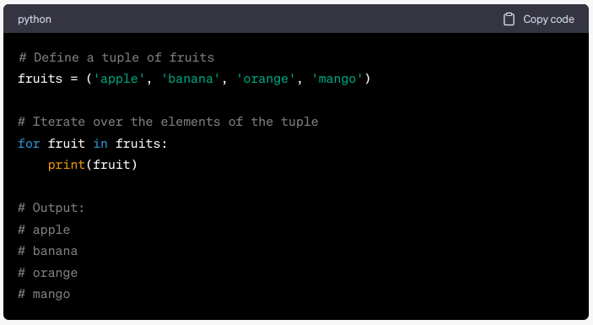
Tuples
Iterate over tuples
Credit: Ana Bell, Eric Grimson, John Guttag (2016). Introduction to Computer Science and Programming in Python [PowerPoint slides].
Notes:
In this example, we have a tuple called fruits that contains different types of fruits. We use a for loop to iterate over each element in the tuple. During each iteration, the current fruit is assigned to the variable fruit, and we print it. As a result, the output displays each fruit on a separate line.
The for loop automatically iterates over all the elements in the tuple, allowing us to perform actions on each element individually. This approach is useful when we want to process or manipulate the elements of a tuple sequentially.

Slide 27
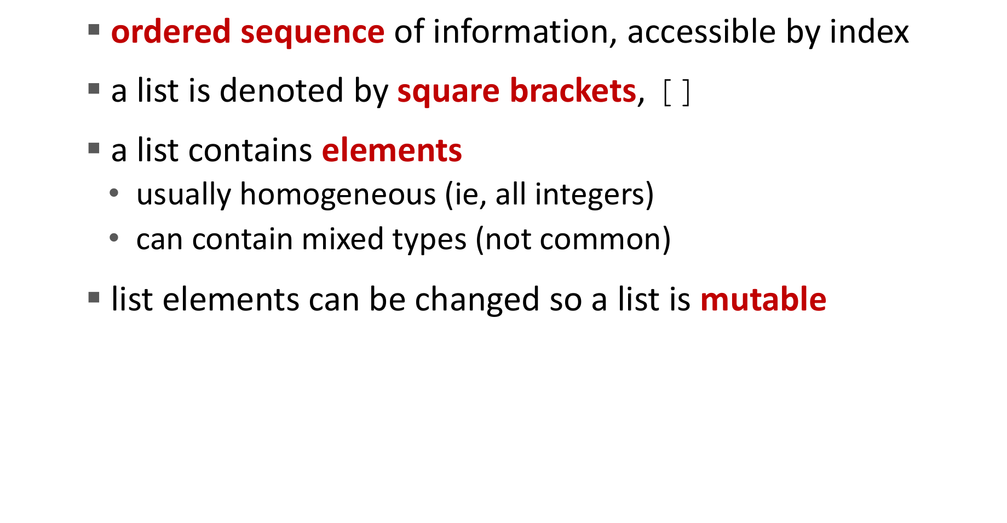
Lists
Credit: Ana Bell, Eric Grimson, John Guttag (2016). Introduction to Computer Science and Programming in Python [PowerPoint slides].
Notes:
In Python, a list is a versatile and mutable data structure used to store an ordered collection of elements.
Lists are enclosed in square brackets [ ] and can contain elements of different types.
The most significant difference is that the elements in list can be changed, while that is not allowed for tuple.

Slide 28
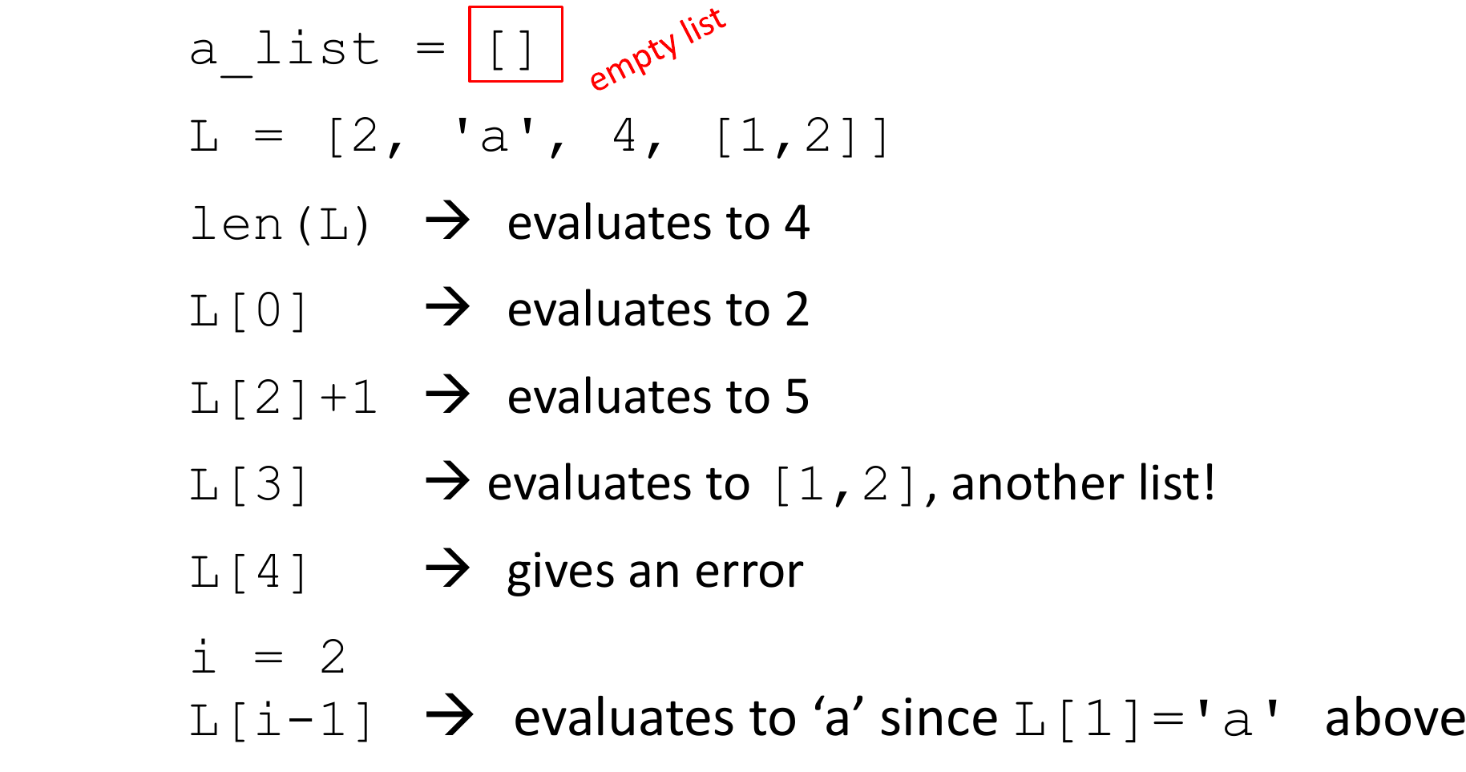
Indices and Ordering
Credit: Ana Bell, Eric Grimson, John Guttag (2016). Introduction to Computer Science and Programming in Python [PowerPoint slides].
Notes:
Here is an example of a list containing multiple types of elements. You can also access the elements within a list the same way as for tuples.

Slide 29
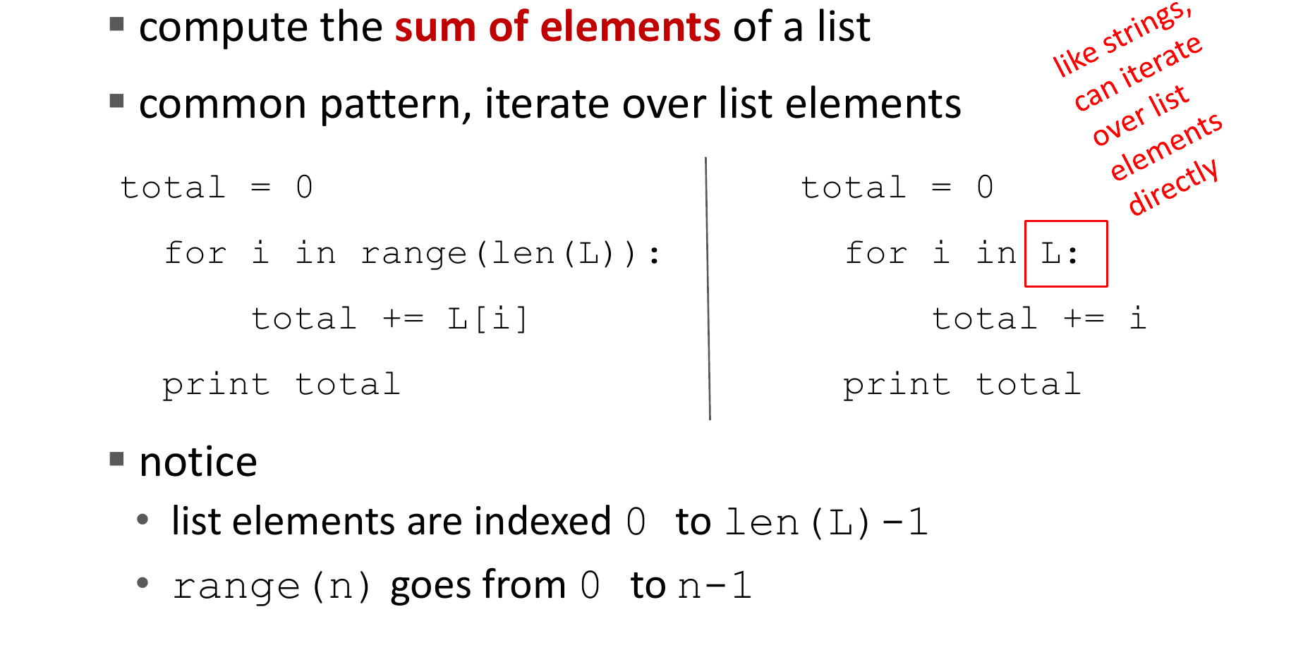
Iterating Over a List
Credit: Ana Bell, Eric Grimson, John Guttag (2016). Introduction to Computer Science and Programming in Python [PowerPoint slides].
Notes:
Similarly, you can also loop over a list using for statement. In this example we want to compute the sum of elements of a list. We can write code like this: In the given code, a variable total is initialized with a value of 0.
Then, a for loop is used to iterate over the indices of the list L. Let's break down the code to understand it:
range(len(L)) generates a sequence of numbers from 0 to len(L)-1, which corresponds to the indices of the elements in the list. Inside the loop, the value of the element at index i in the list L is added to the total. This line accumulates the sum of all elements encountered so far.
After each iteration, we use a print to show the final result.

Slide 30
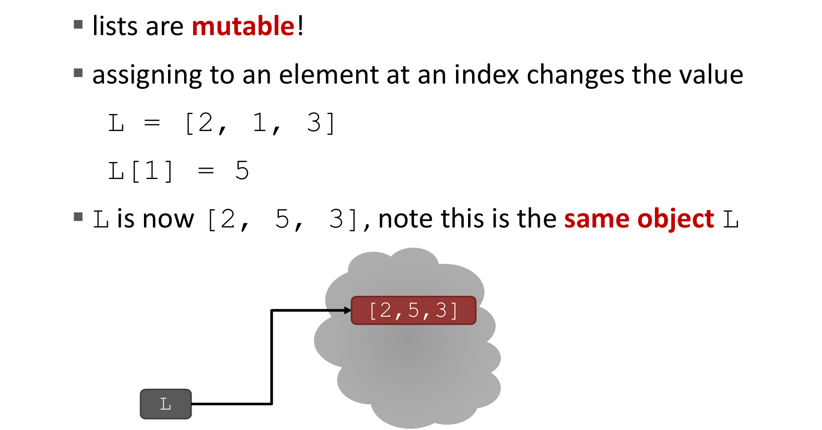
Changing Elements
Credit: Ana Bell, Eric Grimson, John Guttag (2016). Introduction to Computer Science and Programming in Python [PowerPoint slides].
Notes:
As lists are mutable, we can change the elements within a list
For example, here we change the second element in the list L to 5.
Lists support various operations, including adding elements with append() or extend(), removing elements with remove() or pop(), and modifying elements by assignment. Which we will see later

Slide 31
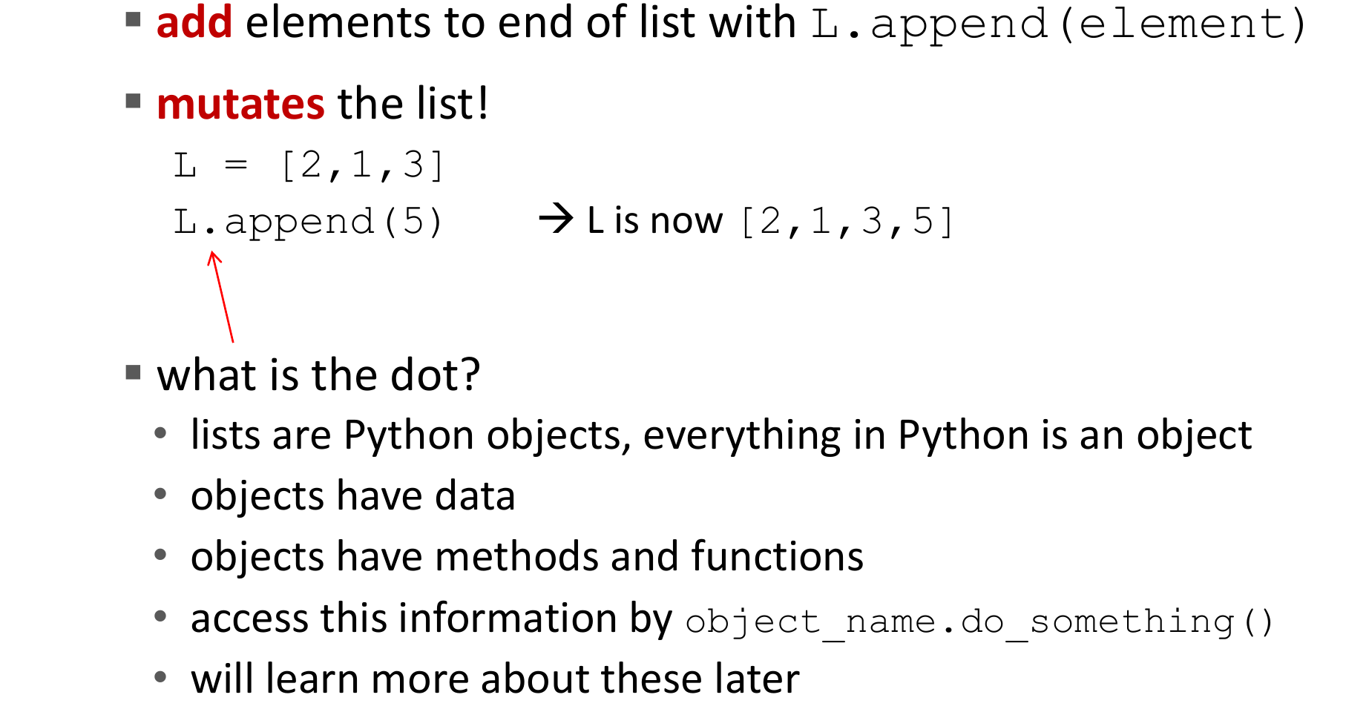
Operations on Lists: Add
Credit: Ana Bell, Eric Grimson, John Guttag (2016). Introduction to Computer Science and Programming in Python [PowerPoint slides].
Notes:
The append() method is used to add a single element to the end of a list.
Syntax: list.append(element)
Example: my_list = [1, 2, 3]; my_list.append(4) will result in my_list becoming [1, 2, 3, 4].
The append() method modifies the original list by adding the element at the end.

Slide 32
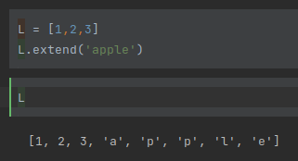
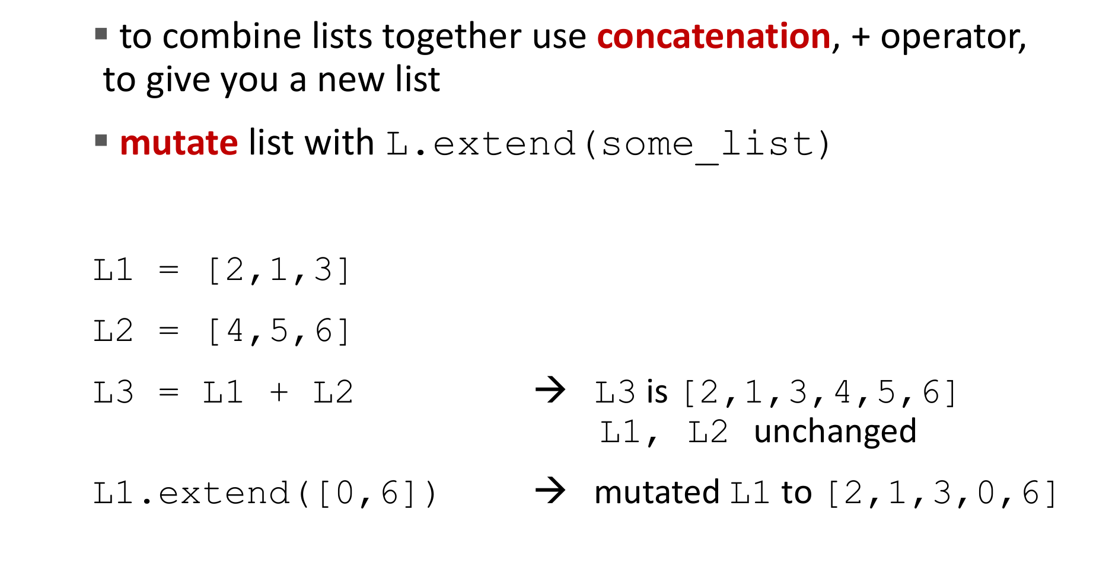
Operations on Lists: Add
Credit: Ana Bell, Eric Grimson, John Guttag (2016). Introduction to Computer Science and Programming in Python [PowerPoint slides].
Notes:
The extend() method is used to add multiple elements to the end of a list.
Syntax: list.extend(iterable)
The extend() method takes an iterable (such as a list, tuple, or string) and adds each element individually to the end of the list.
It's important to note that both append() and extend() modify the original list in-place, meaning they directly modify the list object without returning a new list.

Slide 33
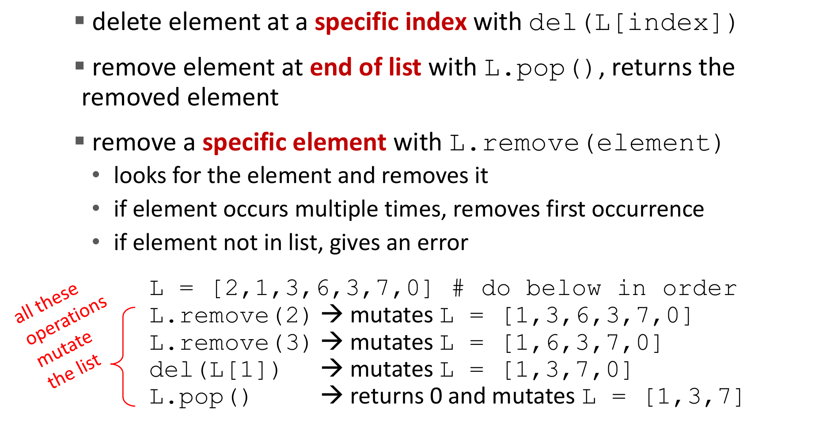
Operations on Lists: Remove
Credit: Ana Bell, Eric Grimson, John Guttag (2016). Introduction to Computer Science and Programming in Python [PowerPoint slides].
Notes:
Here's an introduction to three common methods used to remove elements from a list in Python: del, pop(), and remove().
del Statement:
The del statement allows you to remove elements from a list using the index.
Syntax: del list[index]
The del statement modifies the original list by deleting the element at the specified index.
pop() Method:
The pop() method removes and returns an element from a list based on the index.
Syntax: list.pop(index)
If no index is specified, pop() removes and returns the last element in the list.
The pop() method modifies the original list by removing the specified element.
remove() Method:
The remove() method removes the first occurrence of a specified value from a list.
Syntax: list.remove(value)
If the value is not found in the list, a ValueError is raised.
The remove() method modifies the original list by deleting the specified value

Slide 34
Exercise: Tuple and List
Create a tuple named my_tuple with the following elements: "apple", "banana", "cherry", "apple".
Create a list named my_list with the same elements as my_tuple.
Hint: you can use list(my_tuple)
Print the length of my_tuple.
Print the length of my_list.
Add an element "orange" to my_list using the appropriate method.
Remove the element "cherry" from my_list using the appropriate method.
Print my_list to verify the modifications.
Use the pop() method to remove and print the last element from my_list.
Print the modified my_list to verify the modifications.

Slide 35
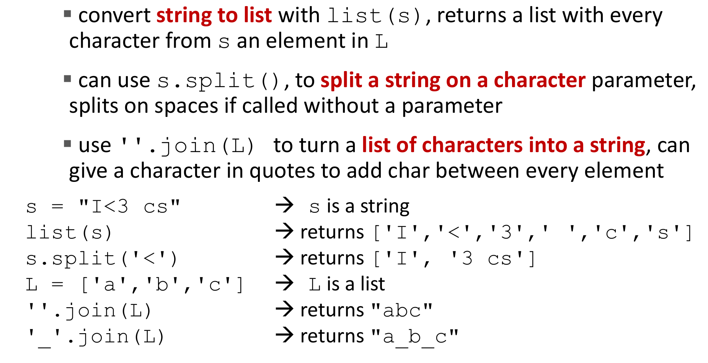
Convert Lists to Srtings
Credit: Ana Bell, Eric Grimson, John Guttag (2016). Introduction to Computer Science and Programming in Python [PowerPoint slides].
Notes:
Here's an introduction to the join() and split() methods in Python for converting between lists and strings:
split() Method:
The split() method is used to split a string into a list of substrings based on a delimiter.
Syntax: string.split(separator)
The split() method divides the string at each occurrence of the separator and returns a list of substrings.
If no separator is provided, the split() method splits the string by whitespace characters by default.
join() Method:
The join() method is used to concatenate elements of an iterable (such as a list) into a single string.
Syntax: separator.join(iterable)
The join() method takes an iterable as an argument and concatenates its elements using the specified separator.
The separator can be an empty string ('') or any desired character or string.
These methods are useful for converting between lists and strings in Python

Slide 36
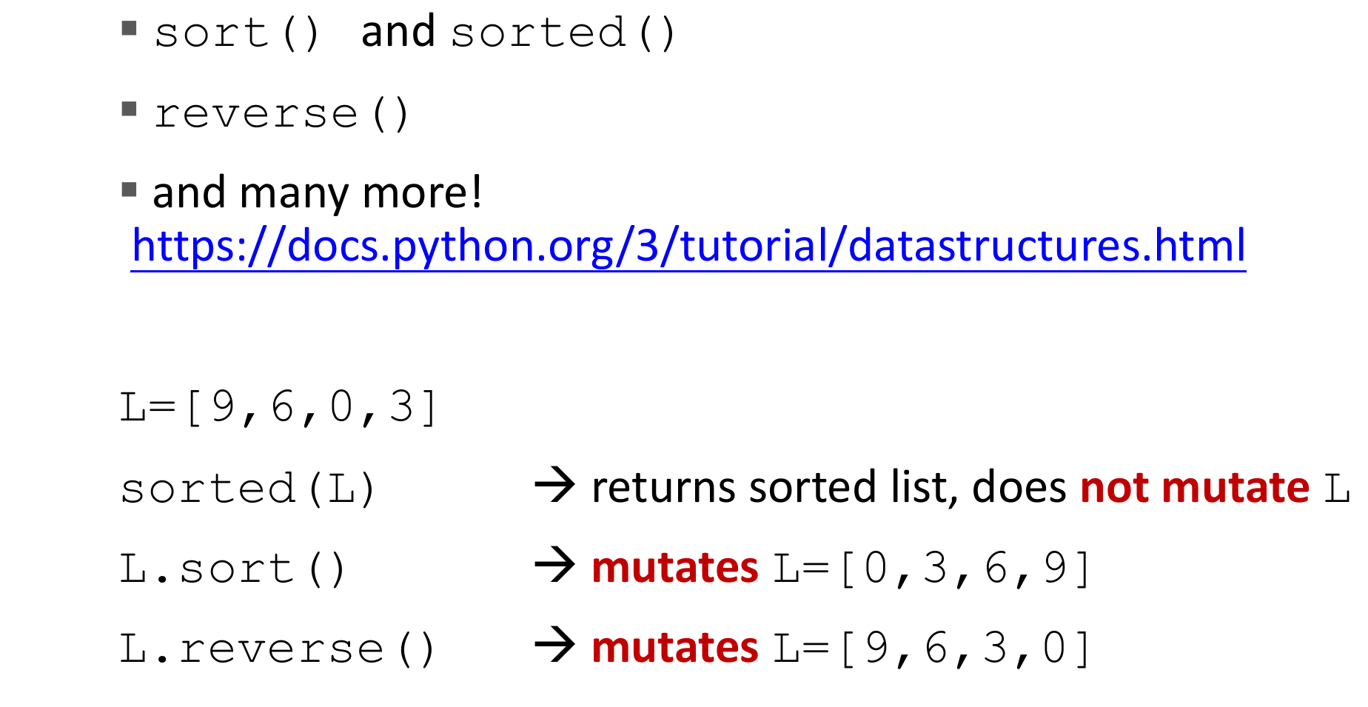
Other List Operations
Credit: Ana Bell, Eric Grimson, John Guttag (2016). Introduction to Computer Science and Programming in Python [PowerPoint slides].
Notes:
Here's a brief introduction to three common operations for manipulating lists in Python: sort(), sorted(), and reverse().
sorted() Function:
The sorted() function is used to create a new list containing a sorted version of the original list.
Syntax: sorted(list)
sort() Method:
The sort() method is used to sort the elements of a list in ascending order.
Syntax: list.sort()
The sort() method modifies the list in-place and does not return a new sorted list.
reverse() Method:
The reverse() method is used to reverse the order of elements in a list.
Syntax: list.reverse()
The reverse() method modifies the list in-place and does not return a new reversed list.

Slide 37
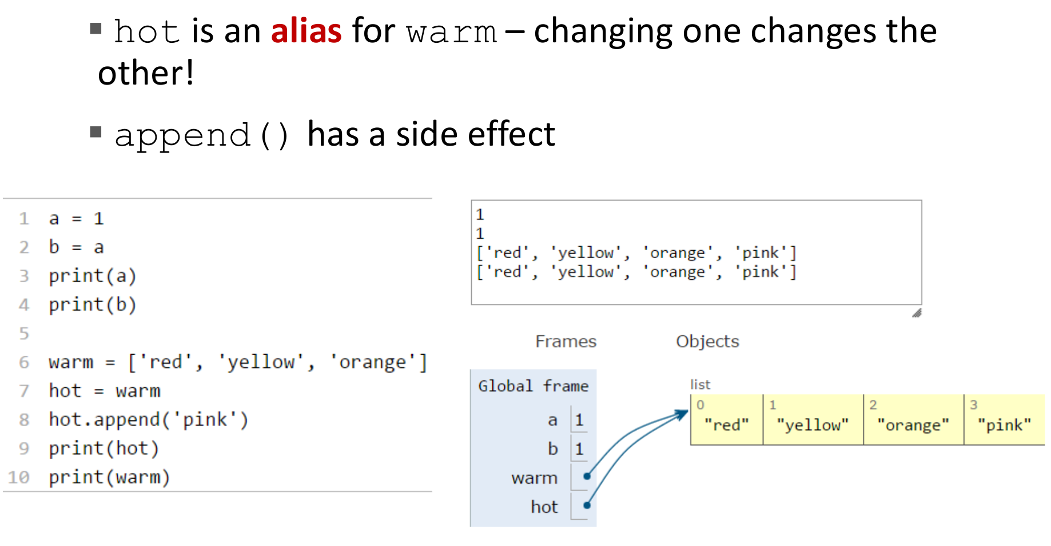
Aliases
Credit: Ana Bell, Eric Grimson, John Guttag (2016). Introduction to Computer Science and Programming in Python [PowerPoint slides].
Notes:
In Python, an alias refers to multiple variables that are assigned to the same object in memory.
When two or more variables refer to the same object, any changes made to the object through one variable will affect all the other variables that are aliases of that object.
In this example, hot and warm are aliases of the same list object. When we use the append() method on hot, it modifies the underlying list object. As a result, both hot and warm will reflect the change, and both will have new value.

Slide 38
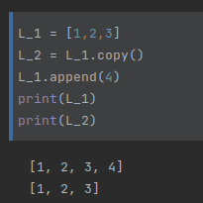
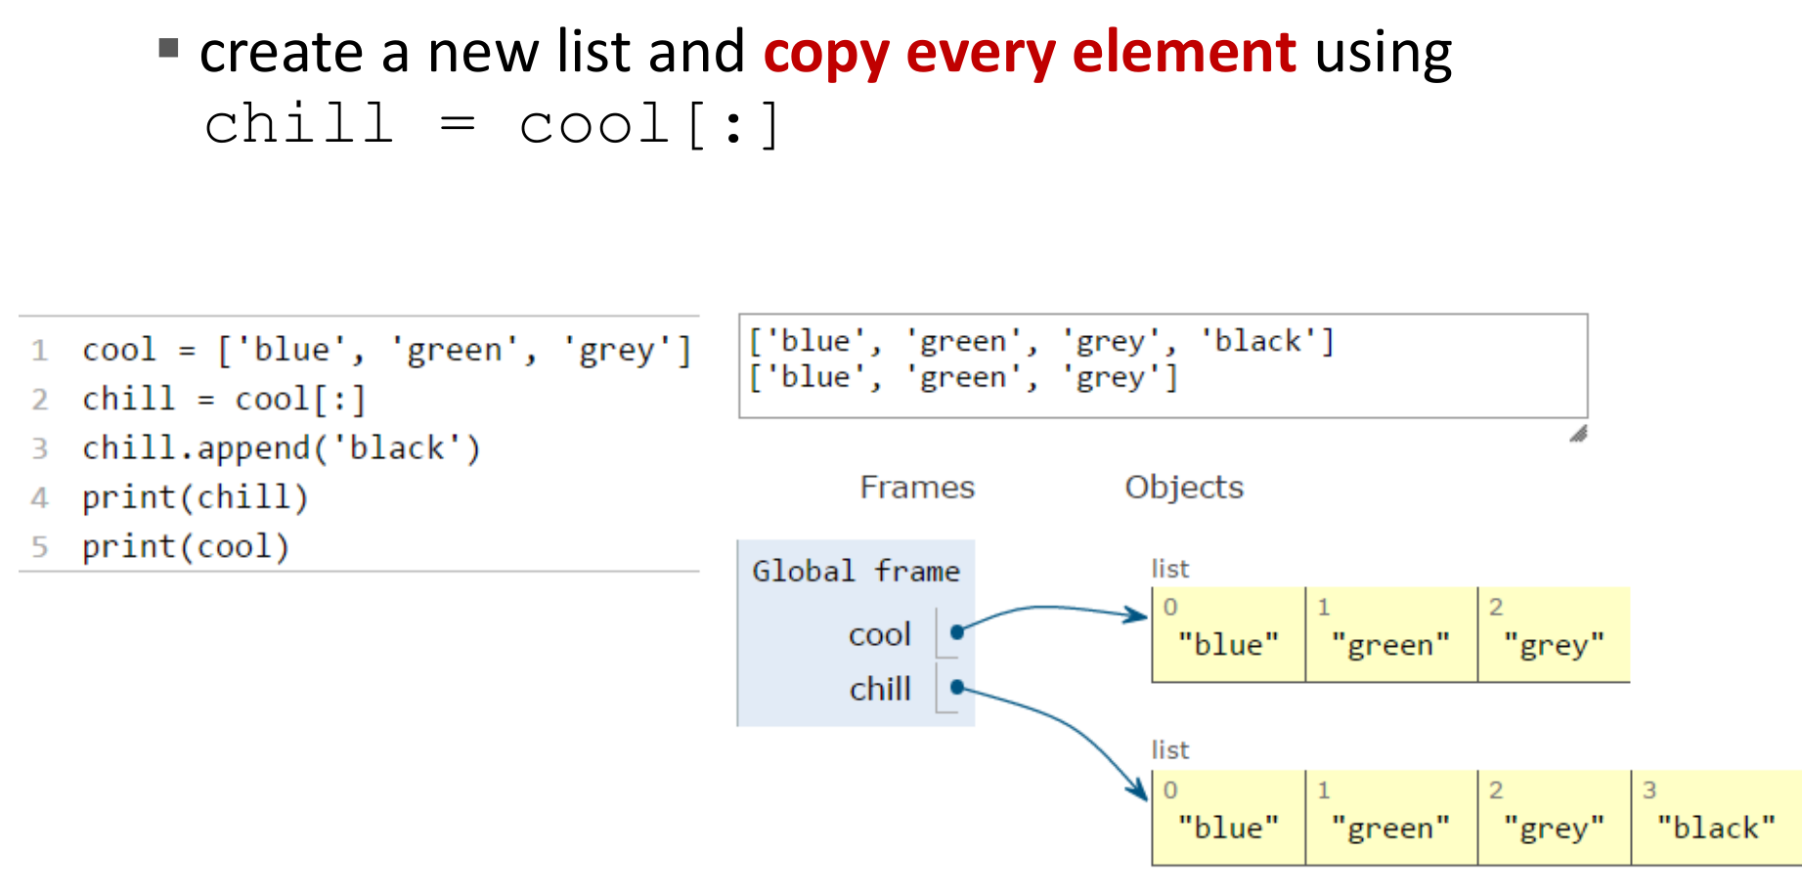
Cloning a List
Credit: Ana Bell, Eric Grimson, John Guttag (2016). Introduction to Computer Science and Programming in Python [PowerPoint slides].
Notes:
To avoid such side effects, you can create a copy of the list using the copy() method or the slicing notation [:] as show n here.
This creates a new independent list object that can be modified separately from the original list.

Slide 39
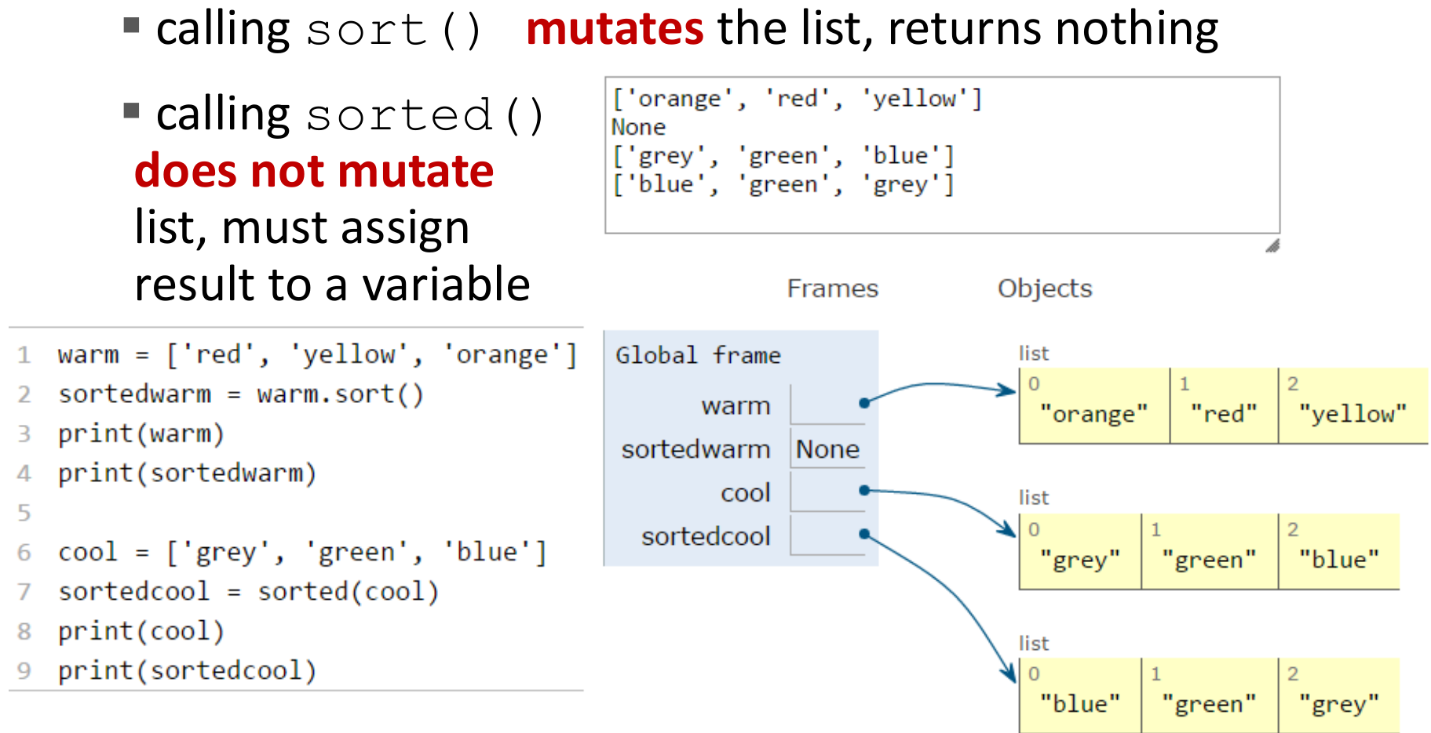
Cloning a List
Notes:
Here is another example when you apply sort and sorted methods.
The dot sort() method mutates the list inplace and returns nothing, so sorted_warm is None.
The sorted() function is used to create a new sorted list from an existing list. So that the sortedcool is a new copy with sorted elements in it

Slide 40
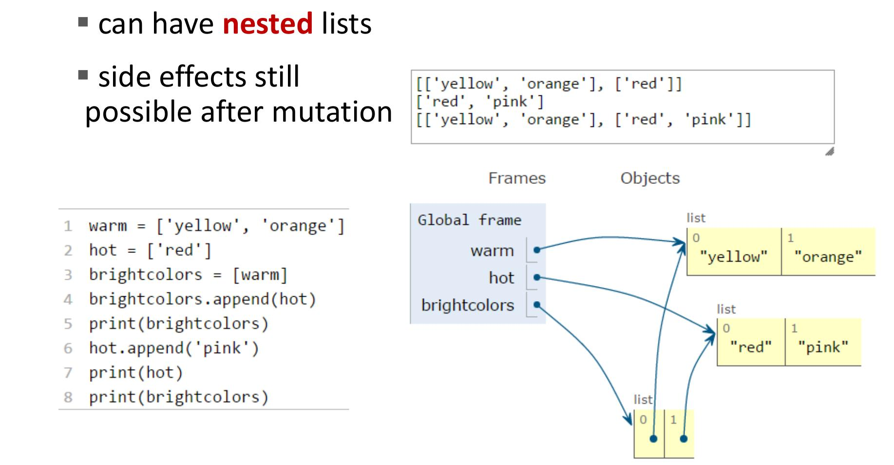
Nested Lists
Credit: Ana Bell, Eric Grimson, John Guttag (2016). Introduction to Computer Science and Programming in Python [PowerPoint slides].
Notes:
Here is an example with nested lists. Similarly, when you create a list of list, which means you create a list that has list as elements,
if you mutate one of the embedded list element, the change will also reflect on the outer list, like the brightcolors here.

Slide 41
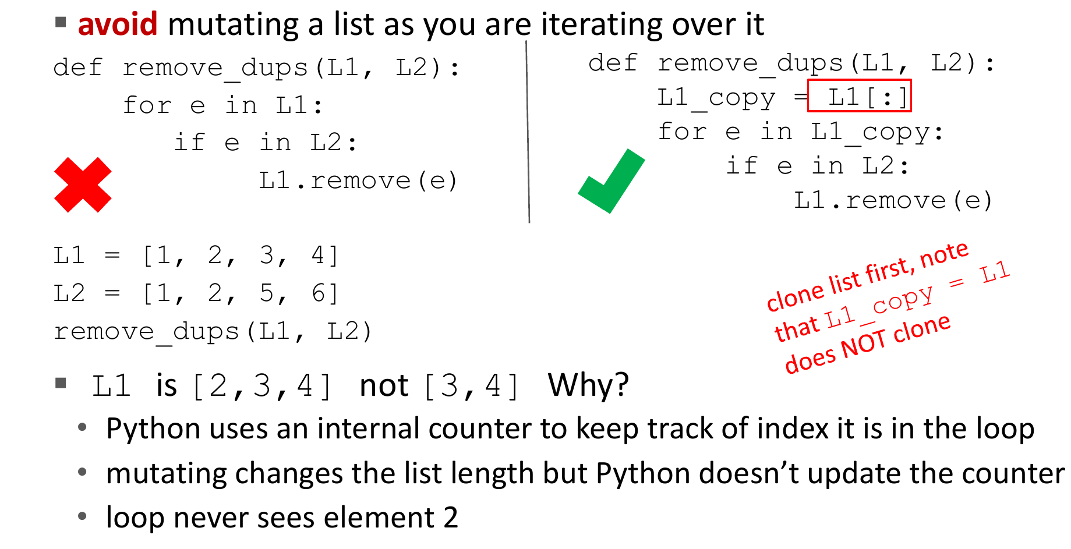
Avoiding mutation during iteration
Credit: Ana Bell, Eric Grimson, John Guttag (2016). Introduction to Computer Science and Programming in Python [PowerPoint slides].
Notes:
Here's a important principle to remember when working with lists or any other mutable objects in Python to prevent unintended side effects.
Let’s say we want to remove all the elements in L1 if the element already exists in L2.
However, directly removing elements from a list while iterating can lead to unexpected results. As the example on the left side,
The reason for this unexpected behavior is that removing elements from the list during iteration causes the indexes to shift, leading to skipped elements.
To avoid this issue, it is recommended to create a new list or use a list comprehension to generate a new list with the desired elements, rather than modifying the original list while iterating over it.

Slide 42
Exercise: List Operations Function
Write a function called list_operations that takes a list as an argument.
Within the function, perform the following operations on the list:
Clone the original list and assign it to a new variable.
Sort the original list in ascending order.
Create an alias of the original list by assigning it to a new variable.
Reverse the alias of the list
Return the cloned list, sorted list, and the alias of the original list.
Test the function by calling it with different lists and printing the results.
Notes:
Now let’s check the original list again, we will find that it’s value also change accordingly!

Slide 43
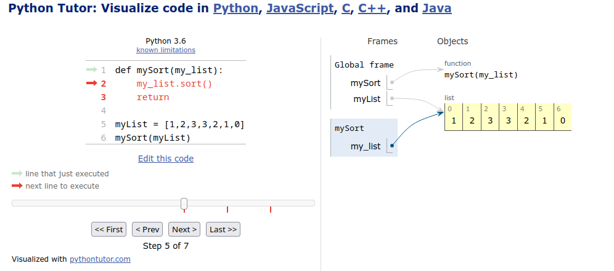
Exercise: List Operations Function
Notes:
Now let’s check the original list again, we will find that it’s value also change accordingly! So is that conflicting to variable scope?
Variable scope primarily refers to the visibility and accessibility of variables within different parts of a program, such as global scope, local scope, and nested scopes within functions.
In the case of modifying a list inside a function, the variable scope is not violated. The variable scope determines where the variable can be accessed and modified, but it does not prevent modifications to mutable objects (like lists) that the variable refers to.
When you pass a list to a function, the function creates a new local reference to the same list object.
Any modifications made to the list object through this reference will affect the original list, regardless of whether the variable itself is in the global or local scope.
In other words, the visibility and accessibility of the variable are determined by its scope, but the changes made to the object the variable refers to can propagate beyond the scope.
To avoid unintentional modifications to a list, you can create a copy of the list within the function or use alternative methods that do not modify the original list.
This helps maintain the intended behavior of variable scope and prevents unintended side effects.
So, while modifications to objects within a function can impact variables outside of its scope, it is still consistent with the concept of variable scope.
def mySort(myList):
myList.sort()
return
myFirstList = [1,2,3,3,2,1]
mySort(myFirstList)
print(myFirstList)

Slide 44
Exercise: List Operations Function
Notes:
In this code, we have a function mySort that takes a list my_list as an argument. Inside the function, the sort() method is called on my_list, which sorts the elements of the list in-place. The function doesn't return anything explicitly.
Outside the function, we have a variable myList that references the list [1, 2, 3, 3, 2, 1, 0]. We then call the mySort function and pass myList as an argument.
Here's what happens step by step:
The list [1, 2, 3, 3, 2, 1, 0] is assigned to the variable myList.
The mySort function is called with myList as an argument.
Inside the mySort function, the sort() method is called on my_list, which modifies the list in-place. This means that the elements of the list are rearranged in ascending order.
The function does not return any value explicitly.
After the function call, if we print myList, we will see that the list has been modified and is now [0, 1, 1, 2, 2, 3, 3].
Now, let's talk about the concept of variable scope. In this code, my_list is a parameter of the mySort function. It has a local scope, which means it is accessible only within the function. When we call mySort and pass myList as an argument, a reference to the list object is passed to the function. Any modifications made to the list within the function will affect the original list.
In this case, the sort() method modifies the list in-place. Since the list object referenced by my_list is the same as the one referenced by myList, any changes made inside the function will be visible outside of the function as well.
This behavior is consistent with the concept of variable scope. The visibility and accessibility of my_list are limited to the scope of the mySort function, but modifications to the object it refers to can propagate beyond the scope.
To summarize, even though the modification of the list inside the function affects the variable outside the function, it does not violate the concept of variable scope. The scope determines where the variable can be accessed, but the changes made to the object itself can be observed beyond the scope.

Slide 45
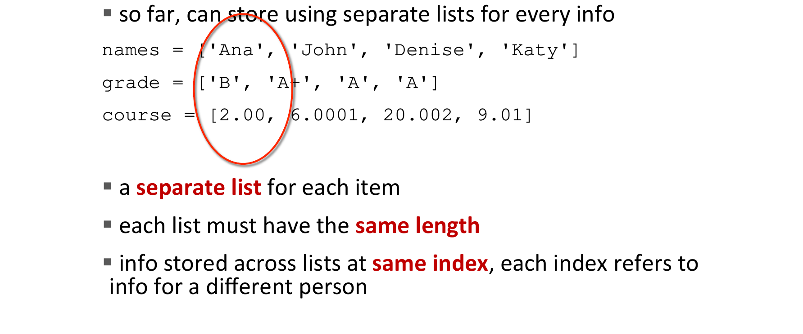
Dictionary
e.g., how to store student info
Credit: Ana Bell, Eric Grimson, John Guttag (2016). Introduction to Computer Science and Programming in Python [PowerPoint slides].
Notes:
The data type of a dictionary in Python is a collection of key-value pairs.
It allows you to store and retrieve data based on unique keys. Dictionaries are very useful when you need to associate related information together.
Let's use the example of storing student information to illustrate the benefits of using a dictionary.
If we want to store the students' names, grades, and courses using a list, it would be more complicated.
Here's an example of how it might look using lists:
you need to make sure that the corresponding indices match for each student's information.
If the order is not maintained or if you want to add additional information (e.g., age, address, etc.), it becomes challenging to keep track of everything accurately.

Slide 46
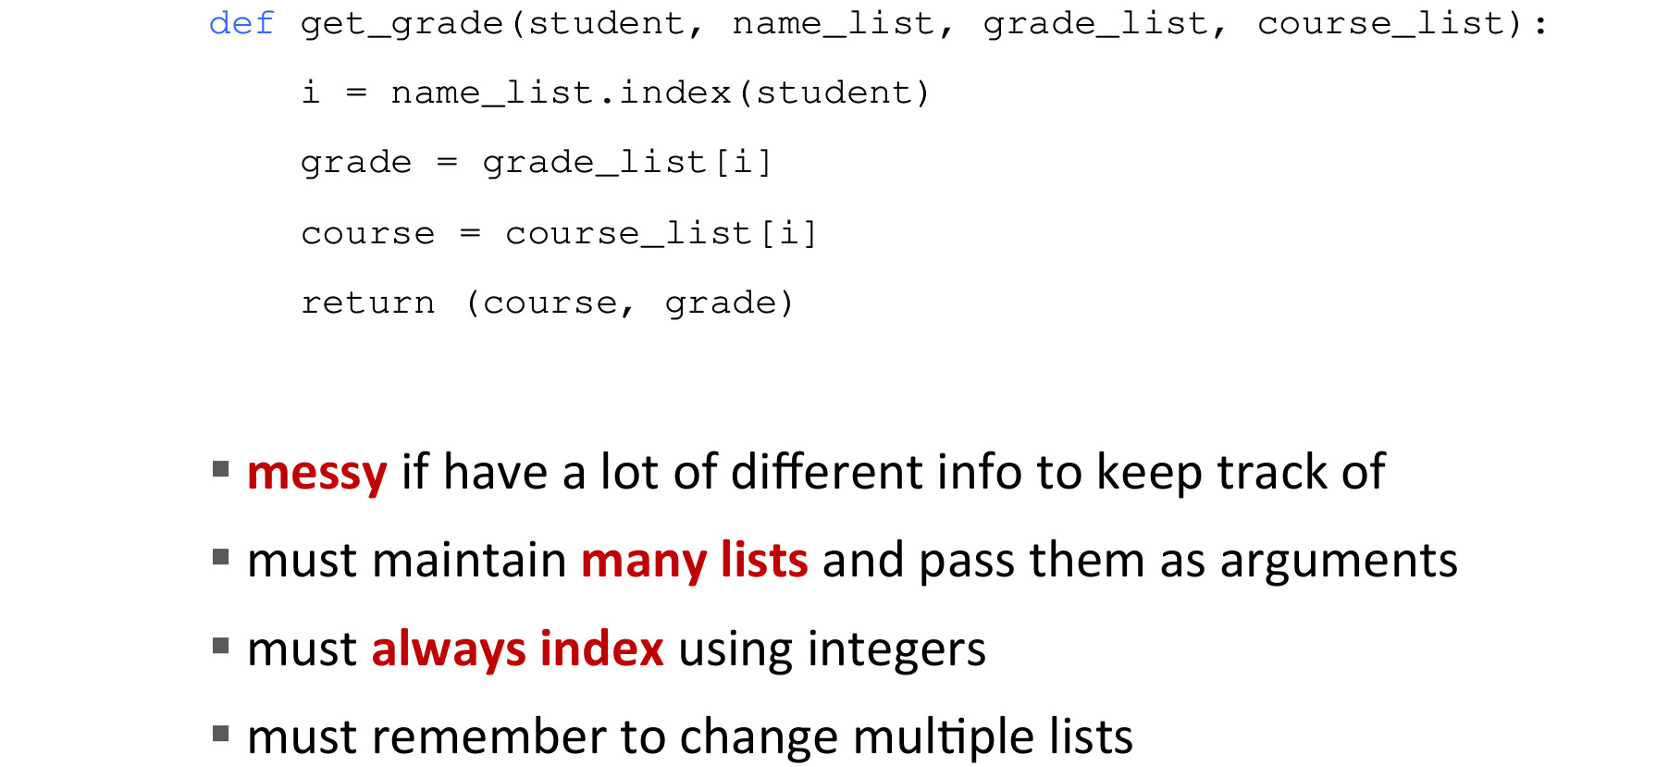
Dictionary
e.g., how to store student info
Credit: Ana Bell, Eric Grimson, John Guttag (2016). Introduction to Computer Science and Programming in Python [PowerPoint slides].
Notes:
It's also messy and complicated if you want to access the stored information. Say if we want to collect the grade and the course information about a student.
You first need to get the index correctly, then, based on the index, you can finally retrieve the other information

Slide 47
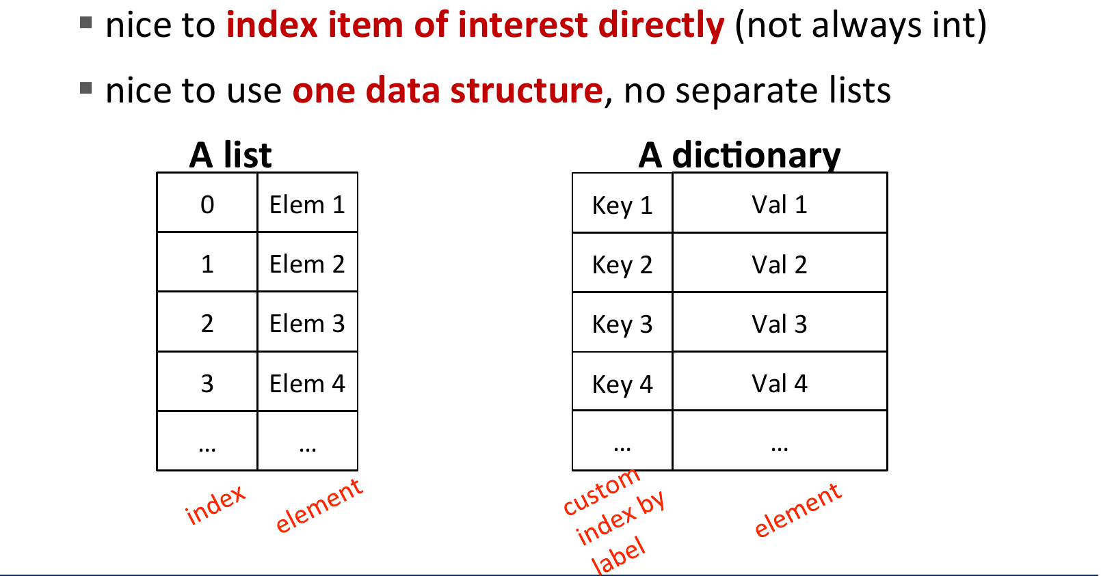
Dictionary
e.g., how to change student info
dict: a better and clearner way
Credit: Ana Bell, Eric Grimson, John Guttag (2016). Introduction to Computer Science and Programming in Python [PowerPoint slides].
Notes:
However, using a dictionary, we can organize the information in a more intuitive and efficient way.
Each student's information can be represented as a key-value pair, with the keys being unique identifiers like student IDs or names.

Slide 48
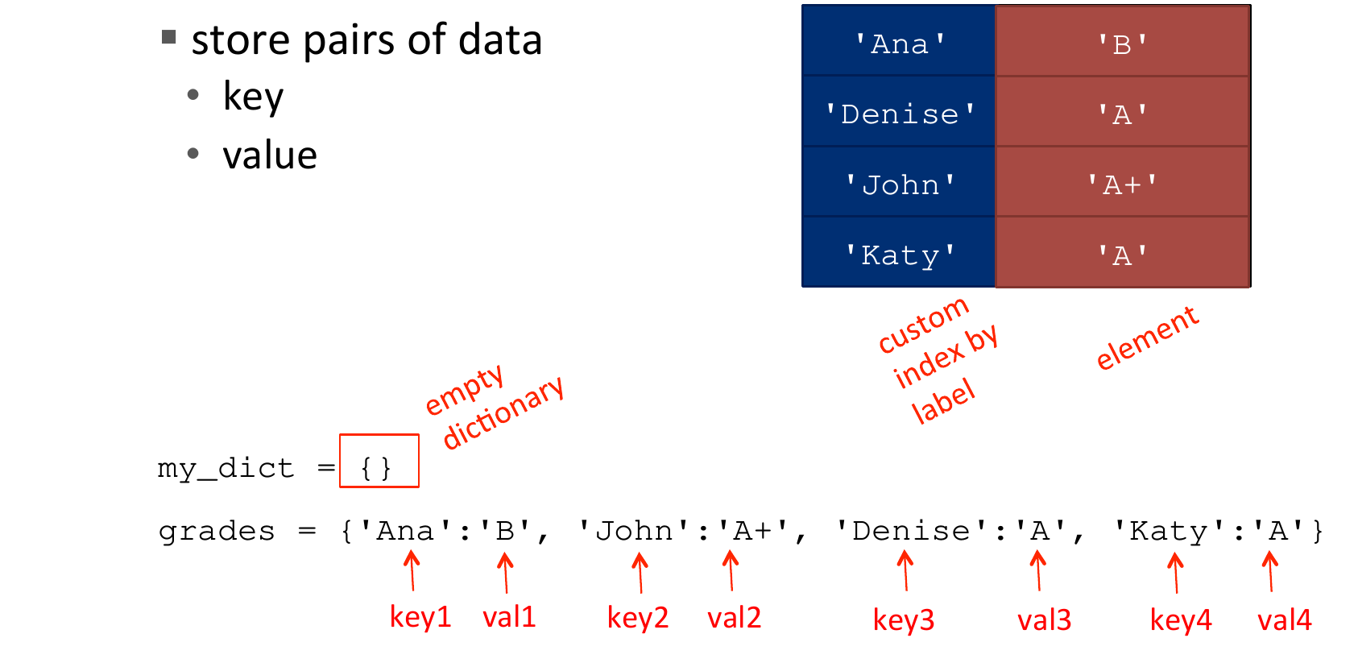
Python Dictionary
Credit: Ana Bell, Eric Grimson, John Guttag (2016). Introduction to Computer Science and Programming in Python [PowerPoint slides].
Notes:
Here's an example using a dictionary:
In this dictionary, the students' names serve as the keys, and the corresponding values are dictionaries themselves, containing the grade information for each student.
This way, you can easily access and update specific information for a particular student using their name as the key.
Creation: You can create a dictionary by enclosing comma-separated key-value pairs within curly braces {}. Here's an example:

Slide 49
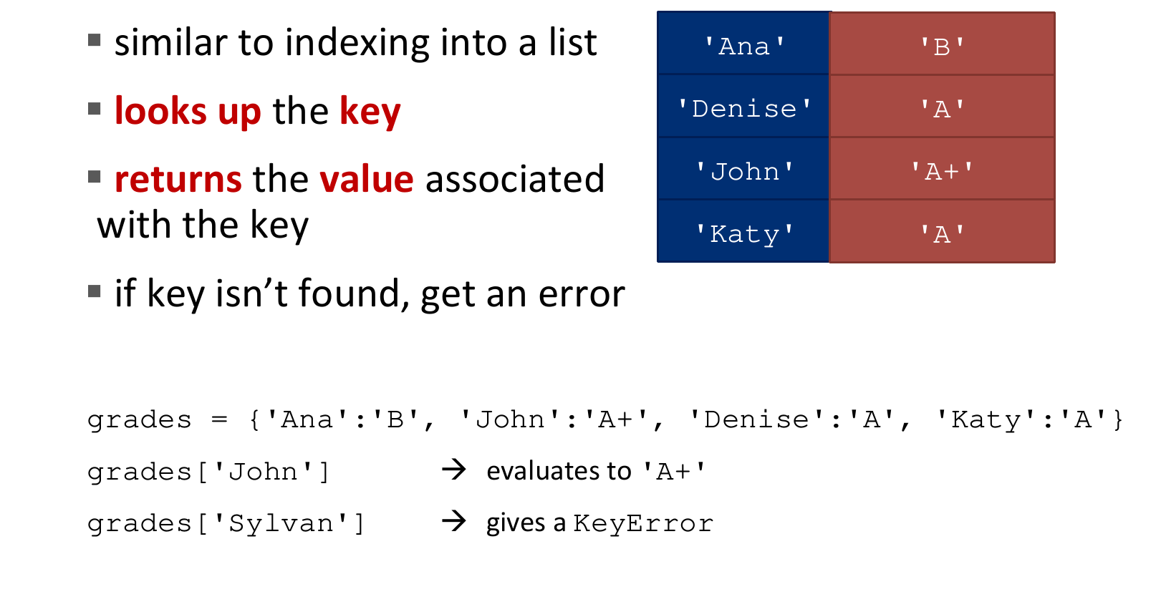
Dictionary Lookup
Credit: Ana Bell, Eric Grimson, John Guttag (2016). Introduction to Computer Science and Programming in Python [PowerPoint slides].
Notes:
Lookup: To access the value associated with a specific key in a dictionary, you can use square brackets [] and provide the key. Here's an example:

Slide 50
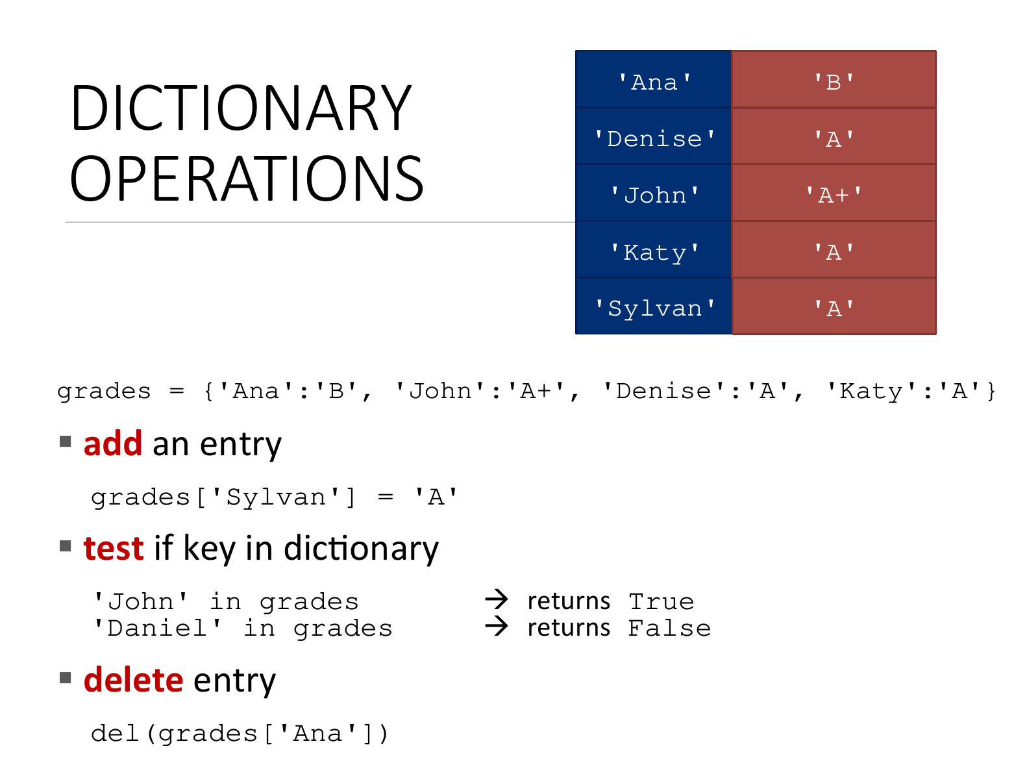
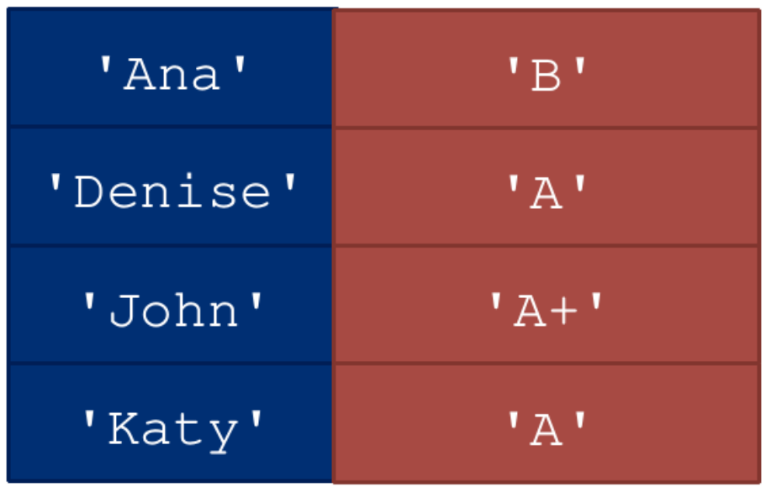

Dictionary Operations
Credit: Ana Bell, Eric Grimson, John Guttag (2016). Introduction to Computer Science and Programming in Python [PowerPoint slides].
Notes:
Add or Update: You can add a new key-value pair to a dictionary or update the value of an existing key. Here's an example:
Check if Key Exists: To check if a specific key exists in a dictionary, you can use the in keyword. It returns True if the key is present and False otherwise. Here's an example:
Delete Entry: You can delete a key-value pair from a dictionary using the del keyword followed by the key. Here's an example:

Slide 51
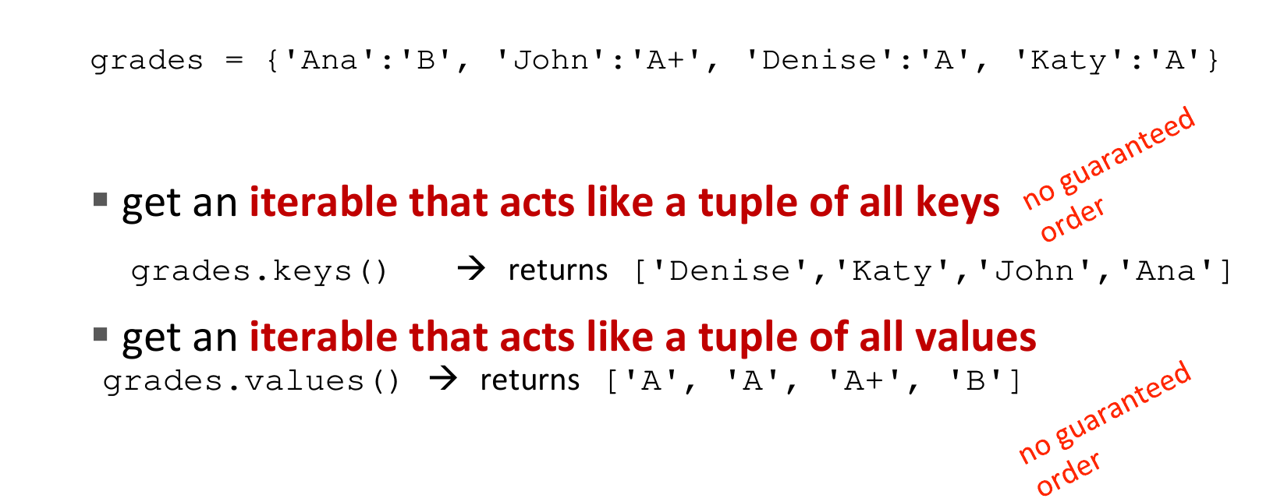
Dictionary Operations
Credit: Ana Bell, Eric Grimson, John Guttag (2016). Introduction to Computer Science and Programming in Python [PowerPoint slides].
Notes:
Check Keys and Values: You can access all the keys and values in a dictionary using the keys() and values() methods, respectively.
Here are some examples:
Note that these operations do not have a guaranteed order of the returned item list.

Slide 52
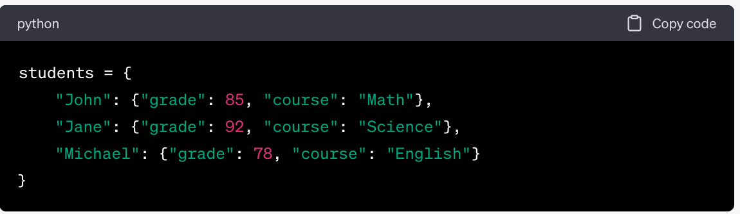
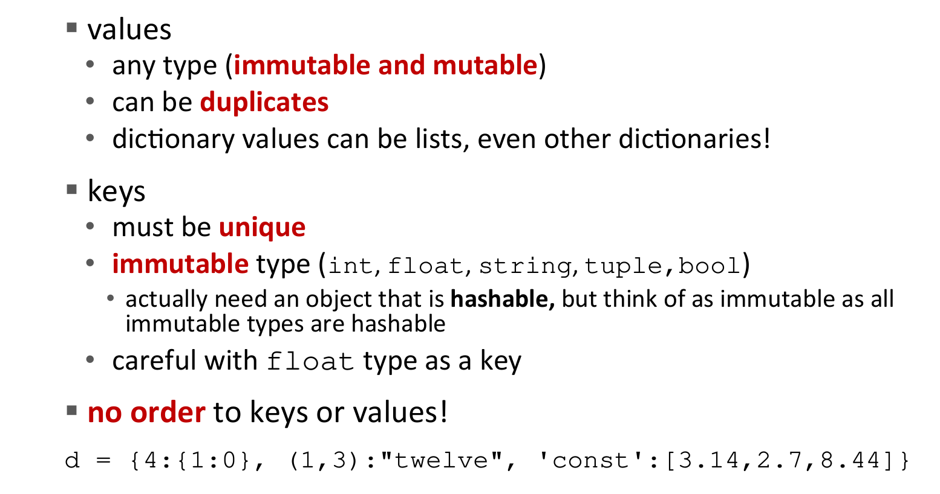
Dictionary Keys and Values
Credit: Ana Bell, Eric Grimson, John Guttag (2016). Introduction to Computer Science and Programming in Python [PowerPoint slides].
Notes:
Note that for dictionary, there are not much constrain for the stored value. It can be any type, different keys can have duplicated values, and we can also create a dictionary where the values are also dictionary!
But for the keys, they have these constrains:
Uniqueness: Keys in a dictionary must be unique. If you try to add a key-value pair with a key that already exists, the new value will overwrite the existing value associated with that key.
Immutability: Keys in a dictionary must be immutable objects. Immutable objects cannot be modified after creation. Examples of commonly used immutable objects as keys include strings, numbers (integers, floats), and tuples (if they only contain immutable elements).

Slide 53
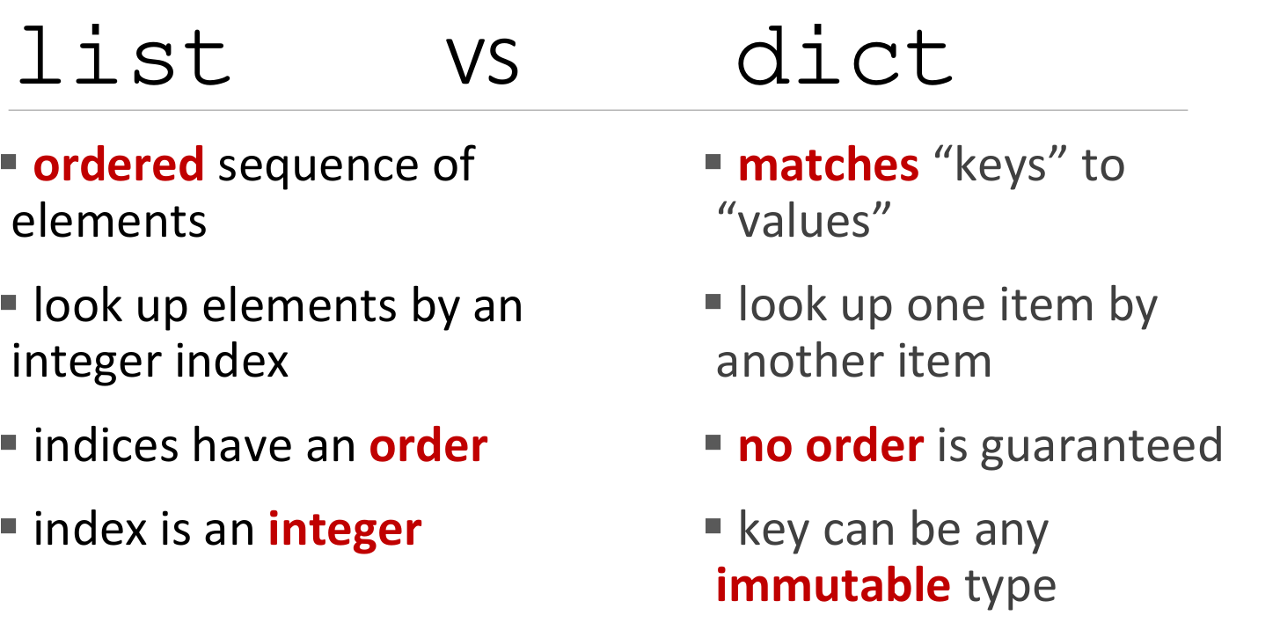
Credit: Ana Bell, Eric Grimson, John Guttag (2016). Introduction to Computer Science and Programming in Python [PowerPoint slides].
Notes:
Here are some key differences between lists and dictionaries in Python:
Data Organization: Lists store elements in an ordered sequence, where each element has an index, while dictionaries store key-value pairs, allowing for easy retrieval of values based on unique keys.
Accessing Elements: In a list, elements are accessed using integer indices, starting from 0. In contrast, dictionaries are accessed using unique keys.
Ordering: Lists maintain the order of elements as they are inserted, while dictionaries do not guarantee any specific order.
Searching: Lists require iterating through elements to find a specific value, which can be time-consuming for large lists. Dictionaries provide constant-time lookup based on the key, making them more efficient for searching.
Duplicate Elements: Lists allow duplicate elements, meaning the same value can appear multiple times. Dictionaries, on the other hand, require unique keys, and duplicate keys will overwrite previous values.
Mutability: Both lists and dictionaries are mutable, meaning you can modify their elements. However, the structure of a dictionary (keys and values) can also be modified, while the structure of a list remains constant.

Slide 54
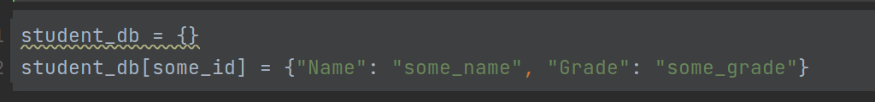
Exercise: Student Database
Create an empty dictionary called student_db.
Add the following student records to the student_db dictionary; using student id as the key:
Student ID: 101, Name: Alice, Grade: A
Student ID: 102, Name: Bob, Grade: B
Student ID: 103, Name: Charlie, Grade: C
Print the student records in the following format:
Update the grade of student with ID 102 to "A+".
Print the updated student record of student with ID 102.
Check if student with ID 104 exists in the student_db dictionary.
Print "Student ID 104 exists" if it exists, or "Student ID 104 does not exist" if it doesn't.
Remove the student record of student with ID 103 from the student_db dictionary.
Print the remaining student records after the removal in the same format as step 3.
Clear all records from the student_db dictionary.
Print the dictionary to confirm that it is empty.
Notes:
# Exercise: Student Database # 1. Create an empty dictionary called student_db. student_db = {} # 2. Add student records to the student_db dictionary. student_db[101] = {"Name": "Alice", "Grade": "A"} student_db[102] = {"Name": "Bob", "Grade": "B"} student_db[103] = {"Name": "Charlie", "Grade": "C"} # 3. Print the student records. for student_id, student_info in student_db.items(): print(f"Student ID: {student_id}, Name: {student_info['Name']}, Grade: {student_info['Grade']}") # 4. Update the grade of student with ID 102 to "A+". student_db[102]["Grade"] = "A+" # 5. Print the updated student record of student with ID 102. print("Updated student record of student with ID 102:") print(student_db[102]) # 6. Check if student with ID 104 exists in the student_db dictionary. if 104 in student_db: print("Student ID 104 exists") else: print("Student ID 104 does not exist") # 7. Remove the student record of student with ID 103. del student_db[103] # 8. Print the remaining student records. print("Remaining student records:") for student_id, student_info in student_db.items(): print(f"Student ID: {student_id}, Name: {student_info['Name']}, Grade: {student_info['Grade']}") # 9. Clear all records from the student_db dictionary. student_db.clear() # 10. Print the dictionary to confirm that it is empty. print("Empty student database:") print(student_db)

